Slide 1
Aphorism
“The journey of a thousand miles begins with a single step.”
Lao Tzu (b.601 BCE)

Slide 2
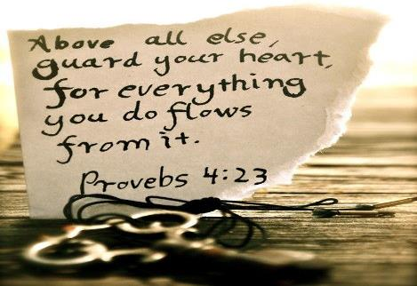
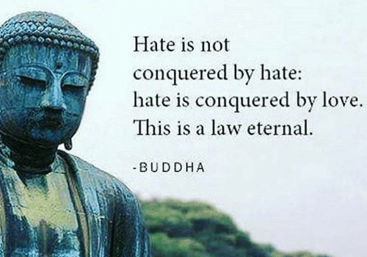
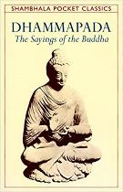
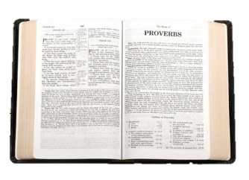
Aphorism
This week’s quote is a well known aphorism found in the writings of the religion, Taoism.
A short, clever and eloquent
saying expressing a general truth.
“The journey of a thousand miles begins with a single step.”
Lao Tzu (b.601 BCE)
Whilst King Solomon wrote books of aphorisms in the Bible.
Life
Eloquent
The Buddhist Dhammapada contains 423 aphorisms by the Buddha.
Key-word
Well expressed, clear and persuasive.
Books of aphorisms can be found in most religions. Sometimes they are referred to as ‘wisdom writings.’

Slide 3
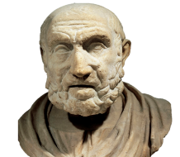
Aphorism
The word aphorism was created by an ancient physician (a doctor) called Hippocrates (d.370 BCE)
A short, clever and eloquent
saying expressing a general truth.
I wrote a book called Aphorisms, with short statements expressing truths about medicine.
Notes:
http://www.unani.com/aphorisms%20by%20hippocrates.htm
https://www.jvascsurg.org/article/S0741-5214(12)01046-4/fulltext

Slide 4
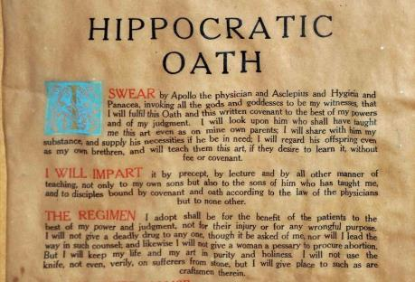
Aphorism
However, Hippocrates is better known for his oaths, or the promises new doctors make.
So let’s all show our appreciation for NHS front line workers by clapping on Thursdays at 8pm.
A short, clever and eloquent
saying expressing a general truth.
Here’s some new doctors pledging themselves to those oaths last month…
Otherwise known as The Hippocratic Oath.
However, the oath doesn’t ask doctors to risk their own lives in the care of others…
When newly qualified doctors take The Hippocratic Oath, they pledge to care, respect and preserve the lives of patients.
But that’s what doctors and other front line NHS staff and keyworkers are currently doing.
Notes:
https://www.avinteractive.com/news/covid-19/medical-students-graduate-virtually-join-nhs-frontline-15-04-2020/

Slide 5
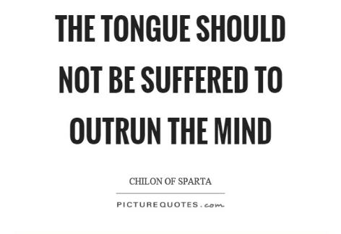
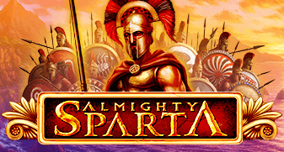
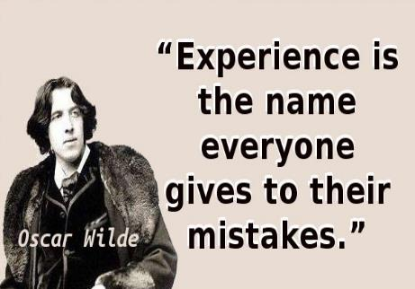
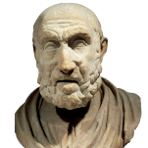
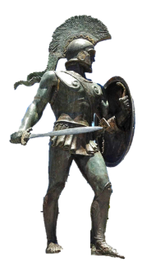
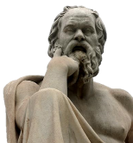
Aphorism
Sparta was a military society, valuing physical and mental prowess. Loquaciousness was discouraged.
Spartan wiseman and leader, Chilon, is credited with the famous aphorism “less is more” and…
Of course, not all sayings are aphorisms. Some sayings simply give information or instruction.
A short, clever and eloquent
saying expressing a general truth.
The word laconic is named after the ancient people of Lacedaemon (or Sparta) in Greece.
Loquacity
Meaningful, based on personal experience, humourous and laconic.
Key word
Talking a great deal: talkative.
They were famed for the brevity of their speech.
Philosopher, Socrates said of the Spartans…
We were dry, sharp and quick witted.
Life
Brevity
Laconic
Dry humour
“If you talk to any ordinary Spartan, they seem to be stupid, but, like an expert marksman, they shoot in some brief remark that proves you to be only a child.”
Aphorisms are usually meaningful, based in experience, sometimes humorous and very often laconic.
Key word
Key term
Key word
The concise and exact use of words in writing or speech.
A person, speech, or style of writing using very few words.
Like Blackadder
A joke said in a serious manner, without emotion, very often by clever person.
Notes:
https://en.wikipedia.org/wiki/Blackadder_Goes_Forth
https://www.history.com/topics/ancient-history/sparta
Richard Holmes commented in his book The Western Front: "Blackadder's aphorisms carry more weight than all the scholarly footnotes in the world."[

Slide 6
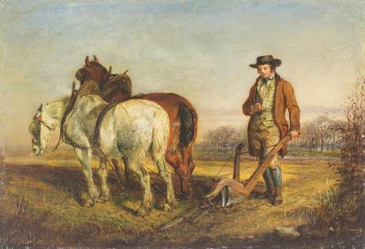
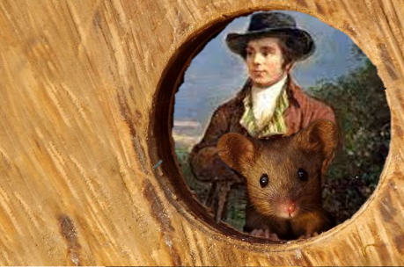
Aphorism
Here’s another famous aphorism which has particular relevance for the UK this weekend.
A short, clever and eloquent
saying expressing a general truth.
The best laid plans of mice and men often go awry.
Robert Burns
What might it mean?
No matter how carefully we plan something, it can always end up going wrong.
How is it particularly relevant to this weekend?
Awry
Key word
Not in the intended manner, out of position, or wrong
The aphorism comes from Burns’ poem, To a Mouse, in which he shows compassion for a mouse after destroying its nest when ploughing his field.
Notes:
Burns at the Plough (Turning Up a Mouse) Gourlay Steel (1819–1894)

Slide 7
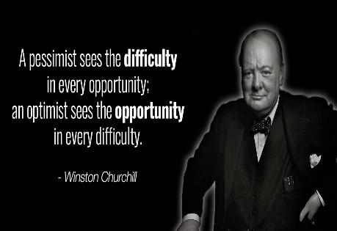
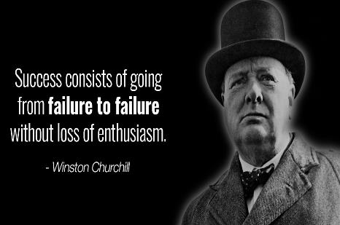
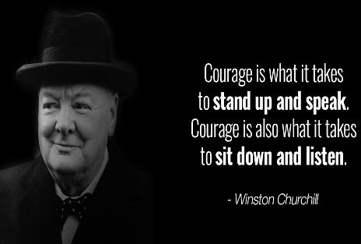
Aphorism
A great motivational, inspirational speaker, Churchill was also pretty good with aphorisms…
Here’s another famous aphorism which has particular relevance for the UK this weekend.
A short, clever and eloquent
saying expressing a general truth.
The best laid plans of mice and men often go awry.
Robert Burns
How is it particularly relevant to this weekend?
Instead, the Queen will address the nation on BBC1 at 9pm, followed by a door step national singalong of the war time song ‘We’ll Meet Again.’
This Friday marks the 75th anniversary VE Day, the formal ending of WWII.
However, plans for UK wide celebrations (e.g. street parties, extended pub hours, Churchill’s original announcement played in public places) have all gone awry, i.e. cancelled or postponed.
On 8th May 1945, the nation cheered as Winston Churchill announced that after 6 years of bitter conflict, claiming millions of lives, WWII was finally over.

Slide 8
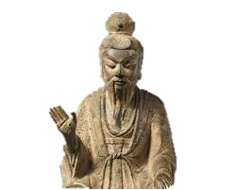
Aphorism
Of course, aphorism’s continue to be created, to reflect the modern world that we live in.
A short, clever and eloquent
saying expressing a general truth.
Can you get this one?
Perhaps you could add an ending to the aphorism?
Life is a rollercoaster…innit.
Life is a roller coaster.
Life is a rollercoaster… you just got to ride it?

Slide 9
Thought for the Week is written to promote, encourage and foster your Spiritual, Moral, Social and Cultural learning.

