Slide 1


Perseverance
“Perseverance is not a long race; it is many short races one after another.”
Walter Eliot (d.1958)

Slide 2







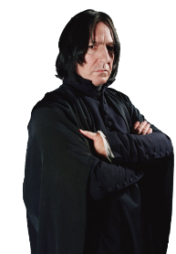
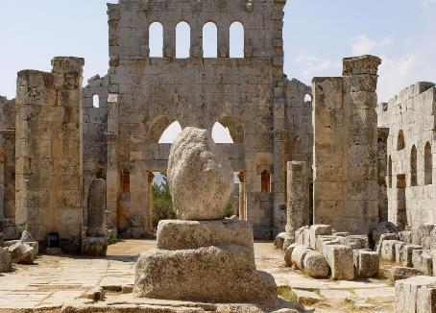

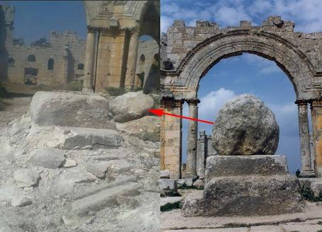



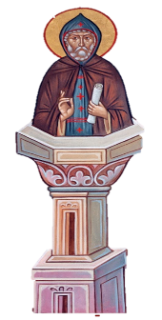
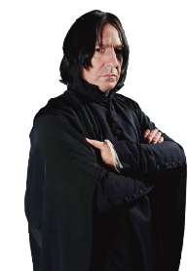

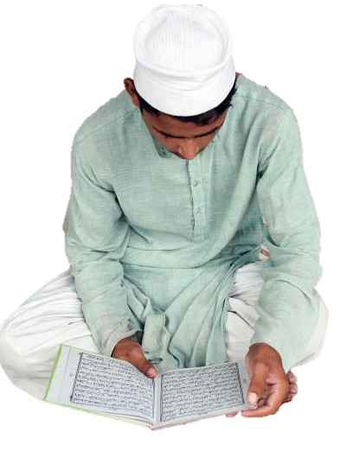

Pilgrimage
Perseverance
Life
Fasting
Key word
Ascetic
There are times when we all need to be
really strict in order to pursue our goals.
Key word
Key-word
To reduce physical needs e.g. the intake of food and water.
.
To visit to a place of religious importance.
.
The spiritual discipline of withdrawing from worldly concerns.
The continued pursuit of a goal despite difficulty or delay.
Less extreme forms of asceticism are found in the fasting practices of Lent and Ramadan.
Inspired by Saint Simon, performer David Blaine once undertook a similar feat of ‘social distancing’.
Sadly, in 2016 the church was hit by a missile during the on-going Syrian war.
Etymology:
Latin: perseverare
per ’very’ + severus ‘severe’ or ‘strict’
Many were inspired by Blaine’s physical and mental perseverance.
That’s from a 1965 film called Simon of the Desert, part-based on Saint Simon.
Whether these goals are chosen for us,
like social distancing...
Why might Saint Simon have done this, do you think?
Was it coincidence that J.K. Rowling called me Severus?
The church ruins and remains of my pillar in 2015.
Or whether these goals are chosen by us,
like social distancing…
The Christian festival of Lent finished recently.
I could teach you a thing of two about social distancing.
What might this physical and mental perseverance be?
What happens during Ramadan?
What is the purpose and benefit of Ramadan?
Simon’s own perseverance was so well respected that shortly that after his death he was honoured with large church, built over the pillar, which became a popular pilgrimage site.
That’s Saint Simon (d.459 C.E.). He spent 37 years living on top of a 15 meter high/1 meter square pillar.
Saint Simon was an extreme Christian ascetic, who devoted his life to prayer and fasting.
The month long fasting festival of Ramadan begins this week on 23rd April.
He was lifted onto a 90ft, 22 inch wide pillar in New York City, where he stood for 35 hours with no sleep and no safety net...
He was really ‘severe’ and ‘strict.’
Notes:
https://en.wikipedia.org/wiki/Simeon_Stylites
https://en.wikipedia.org/wiki/Mortification_of_the_flesh
https://en.wikipedia.org/wiki/Asceticism
https://en.wikipedia.org/wiki/Church_of_Saint_Simeon_Stylites

Slide 3







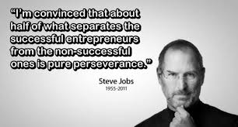
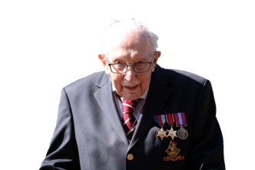


Perseverance
1. Interest: perseverance comes from doing something you’re passionate about.
Growth Mindset
Moving on from pillars and poles, the founder of tech giant, Apple, once said…
Key-word
Personal belief that abilities are not fixed but can be developed.
The continued pursuit of a goal despite difficulty or delay.
Where are these ingredients in the goals you pursue?
Professor, Duckworth, unpacks perseverance in her bestselling book, Grit.
The professor identified the following 4 ingredients necessary for perseverance…
2. Practice: perseverance is being willing and committed to practising for your goals.
.
The total raised by 16th April was £13 million.
So, perseverance isn’t just being really strict and working hard when setting our own goals.
3. Purpose: we persevere because something is meaningful.
Let’s look more closely at what perseverance is and how we get it.
There’s more to perseverance...
Grit is a synonym of perseverance.
4. Growth Mindset: this part of perseverance helps us reframe a potentially negative or difficult situation into a more positive one.
People drop out of things when they’re bored, don’t think it’s worth the effort or that it isn’t important.
That’s 99 year old Captain Tom Moore. He persevered for 100 laps of his garden to raise £1,000 for the NHS.
Perseverance is more than “working really hard” at a goal, as many people often think.
“It's all for the sake of the nurses and the NHS we have because they are doing such a magnificent job.”
Notes:
https://www.psychologytoday.com/gb/blog/functioning-flourishing/201607/grit-the-power-passion-and-perseverance

Slide 4


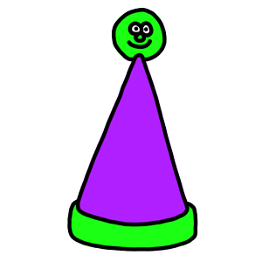


Perseverance
And finally, various studies reveal a direct link between good mental health and perseverance.
The continued pursuit of a goal despite difficulty or delay.
Like dancing!
One study recommends regular exercise as the best way to develop perseverance and good mental health.
Notes:
https://www.psychologytoday.com/gb/blog/the-athletes-way/201905/perseverance-cultivates-purposefulness-and-boosts-resilience

Slide 5
Thought for the Week is written to promote, encourage and foster your Spiritual, Moral, Social and Cultural learning.

