Slide 1
Sleep
“Sleep is the unsung hero of mental health.”
Mark Rowland (Chief Executive of National Sleep Foundation)

Slide 2
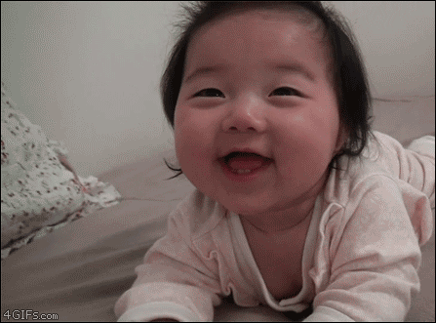
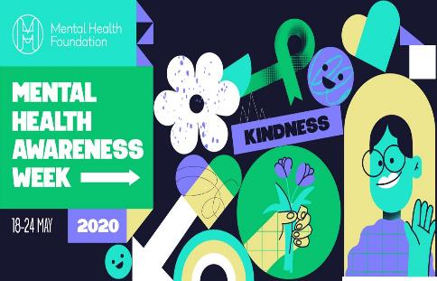
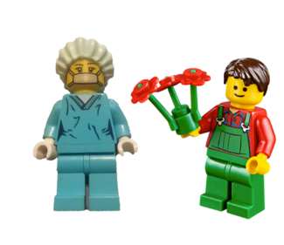
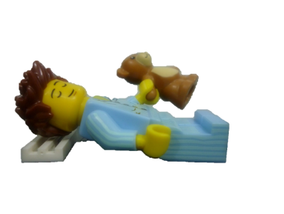
Sleep
Monday 18th May until the 24th May is
Mental Health Awareness Week 2020 .
A state of rest in which the eyes are closed, the body is inactive and the mind does not think.
The original theme for Mental Health Awareness Week was Sleep.
However, this was changed last month to Kindness, in response to Covid 19.

Slide 3
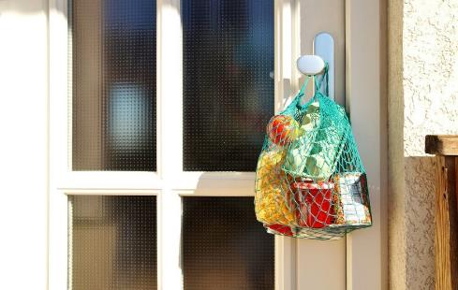
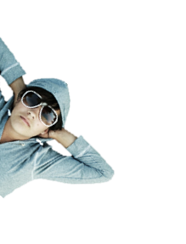
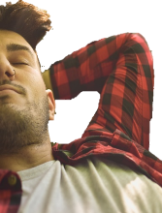
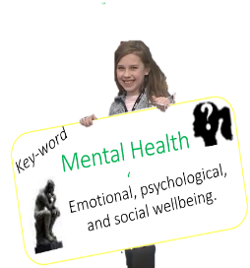
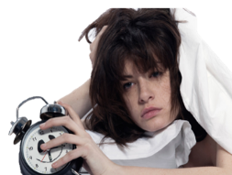
Sleep
So, this week we will look at good mental health during the lockdown, to include sleep and kindness.
A state of rest in which the eyes are closed, the body is inactive and the mind does not think.
Firstly, what do you understand by the term mental health?
Mental health affects how we think, feel and act.
It determines how we handle stress, relate to others and make choices.
Notes:
3kn

Slide 4
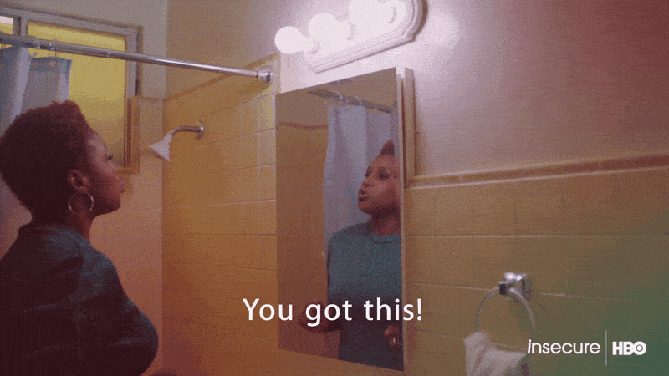
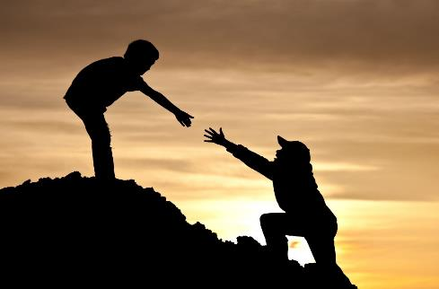
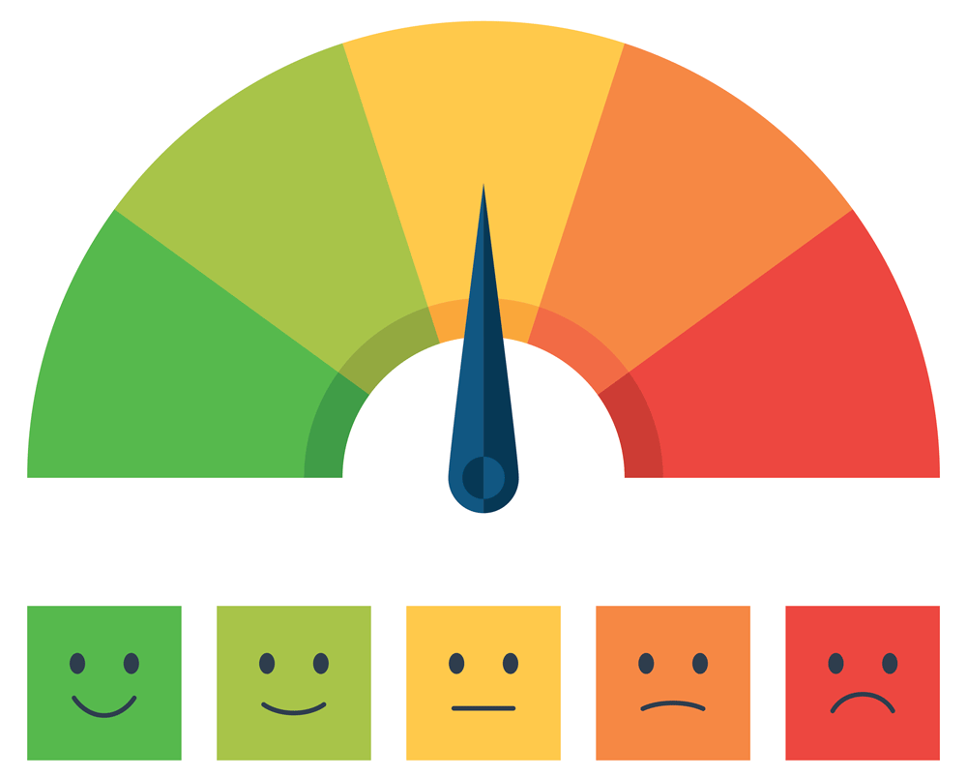
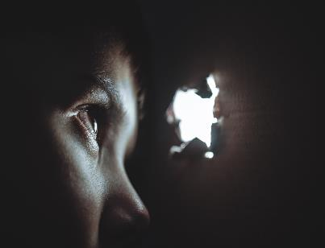
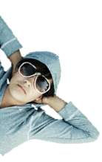
Sleep
Whilst physical health refers to the body, mental health is about what’s going on in our mind…
We can all put ourselves somewhere in the scale of healthy and not so healthy mental states.
A state of rest in which the eyes are closed, the body is inactive and the mind does not think.
Thing we expect
Thing we want
Thoughts
Think of examples of how these mental processes can affect our wellbeing.
Thing we value
Emotions
or feelings
Everyone has a mental life.
Attitudes
Beliefs
Sense of belonging
Everyone is different. You may bounce back from a setback…
Or believing in ourselves and achieving our goals.
e.g. not getting what we want may give rise to emotions, like anger.
…whilst someone else may be weighed down longer by their set backs.
Notes:
10kb

Slide 5
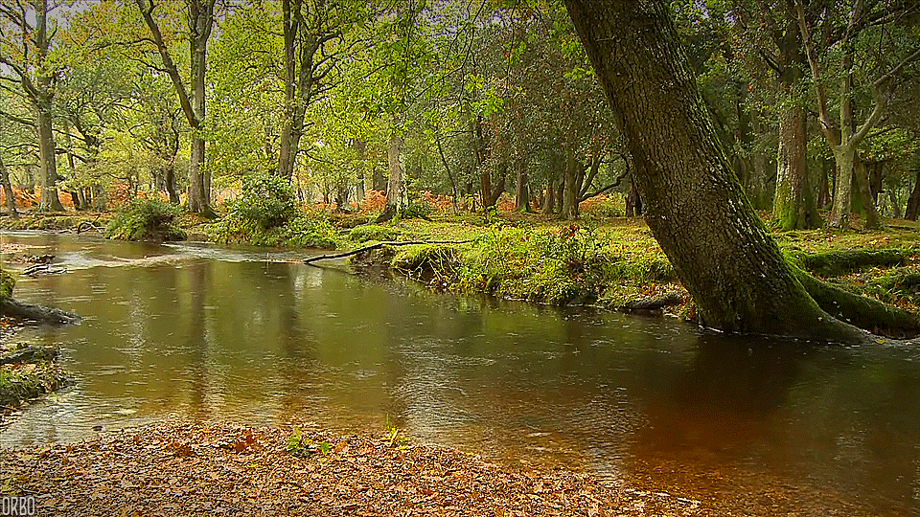
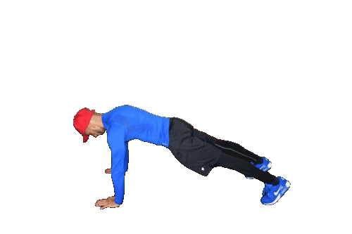
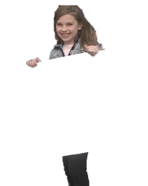
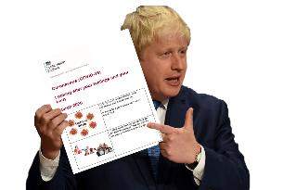
Sleep
Maintaining positive mental health is especially important in these times social distancing.
You are able to go outside to exercise once a day, as long as you keep 2 metres apart from others
A state of rest in which the eyes are closed, the body is inactive and the mind does not think.
What mental health benefits does nature offer?
Here’s a summary of the guidance…
‘Tune in’ to your 5 senses whilst outside.
i.e. What can you hear, feel, smell, see and taste?
Life
1. Get outside
and
enjoy nature
‘
Which is why the government has issued advice on how to look after your mental health during ‘lockdown.’
Notes:
https://www.mentalhealth.org.uk/your-mental-health/about-mental-health/what-mental-health
https://assets.publishing.service.gov.uk/government/uploads/system/uploads/attachment_data/file/876996/Easy_read_looking_after_your_feelings_and_body.pdf
https://www.nhs.uk/oneyou/every-mind-matters/sleep/
https://www.gov.uk/government/publications/covid-19-guidance-on-supporting-children-and-young-peoples-mental-health-and-wellbeing/guidance-for-parents-and-carers-on-supporting-children-and-young-peoples-mental-health-and-wellbeing-during-the-coronavirus-covid-19-outbreak

Slide 6
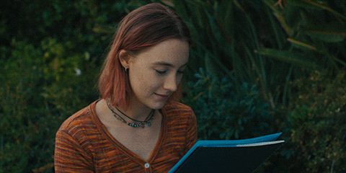
Sleep
What do you enjoy that you can still do at home? Set goals to gain a sense of control and purpose.
A state of rest in which the eyes are closed, the body is inactive and the mind does not think.
What is the something new that you could learn?
Life
2. Do things
you enjoy
‘
Focussing on a hobby or learning something keeps your mind active and boosts your mood.
Notes:
https://www.mentalhealth.org.uk/your-mental-health/about-mental-health/what-mental-health
https://assets.publishing.service.gov.uk/government/uploads/system/uploads/attachment_data/file/876996/Easy_read_looking_after_your_feelings_and_body.pdf
https://www.nhs.uk/oneyou/every-mind-matters/sleep/
https://www.gov.uk/government/publications/covid-19-guidance-on-supporting-children-and-young-peoples-mental-health-and-wellbeing/guidance-for-parents-and-carers-on-supporting-children-and-young-peoples-mental-health-and-wellbeing-during-the-coronavirus-covid-19-outbreak

Slide 7
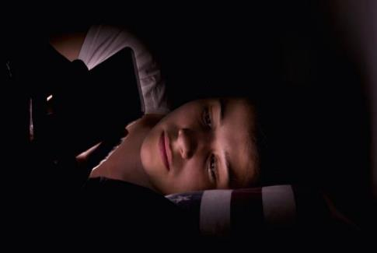
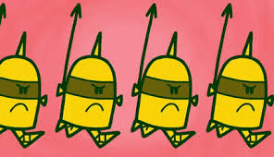
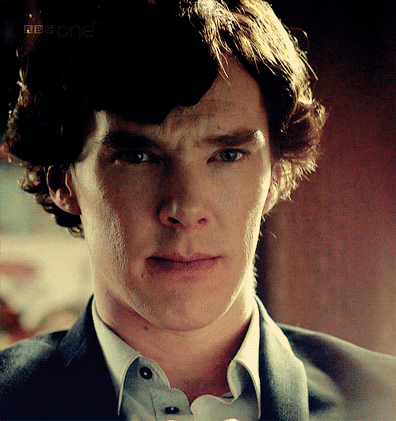
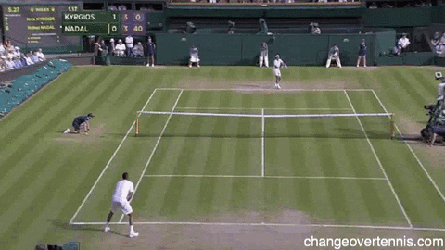
Sleep
“Sleep is the unsung hero of mental health.”
Sleep deprivation reduces your ability to read people’s emotional or facial expressions.
Put simply, good sleep is great for mental health.
Deprivation
Key word
A lack of something considered to be a necessity.
A state of rest in which the eyes are closed, the body is inactive and the mind does not think.
Good sleep really improves speed, accuracy and reaction times.
What can you do to improve your sleep?
Regular sleep boosts your immune system and helps fight illness.
It’s time to sing the praises of sleep…
#3. Make a
habit of
good sleeping.
#3. Make a
habit of
good sleeping.
Our advice: Switch off screens an hour before bed. Use your bed only for sleep and don’t drink caffeine at night.
One study found that poor sleep was linked to slower walking and lower hand-grip strength.
Good sleep improves problem-solving skills, concentration, productivity and memory.
Notes:
https://www.nhs.uk/oneyou/every-mind-matters/sleep/
https://www.mentalhealth.org.uk/a-to-z/s/sleep
https://www.health.harvard.edu/newsletter_article/sleep-and-mental-health
https://www.healthline.com/nutrition/10-reasons-why-good-sleep-is-important#4.-Good-sleep-can-maximize-athletic-performance

Slide 8
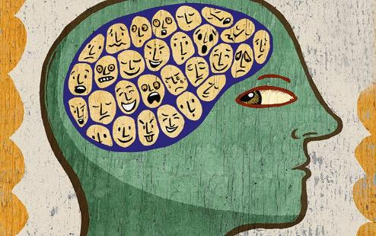
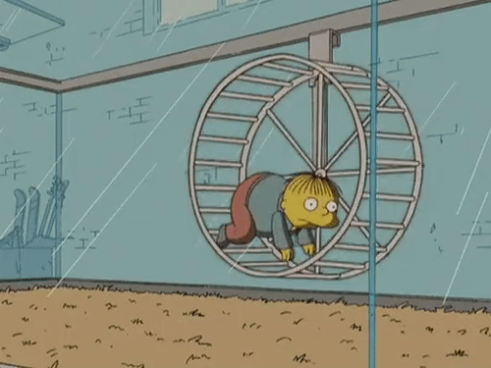
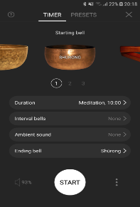
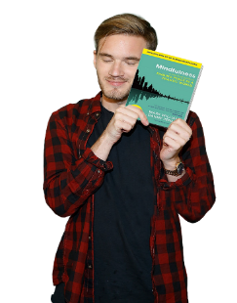
Sleep
Develop a mindfulness practice to quieten the inner restlessness and chattering mind.
A state of rest in which the eyes are closed, the body is inactive and the mind does not think.
Set yourself a timer.
‘Insight Timer’ App
records your daily practice as well as setting your time with beginning, interval and ending gong sounds.
Mindfulness: a practical way to finding peace in a frantic world.
Mark William and Danny Penman.
£14.00
And be ‘mindful’ of the good.
#4 Practice relaxing.
Look after your thoughts and feelings.
If you feel anxious try breathing exercises. See mind.org.uk.

Slide 9
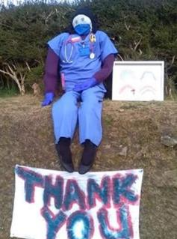
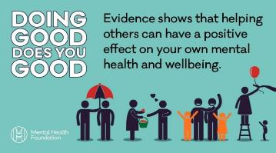
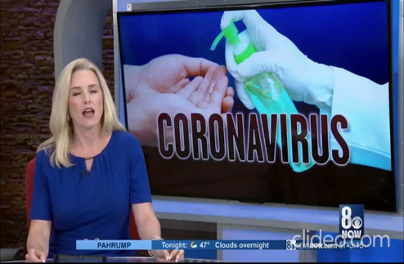
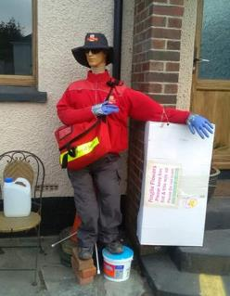
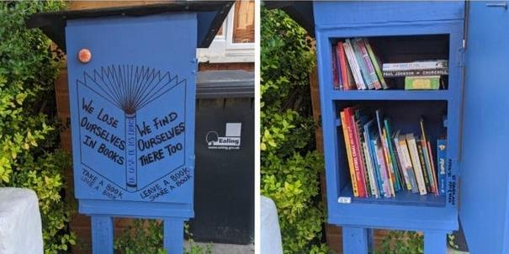
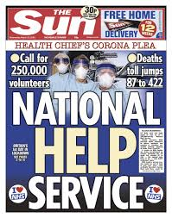
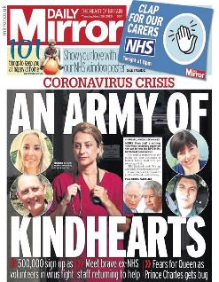
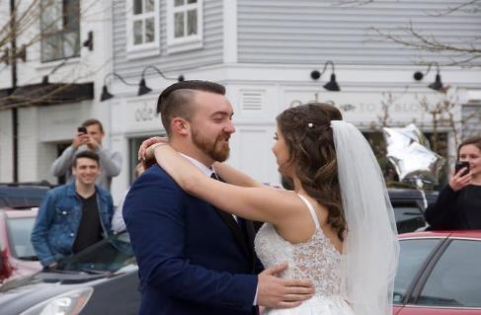
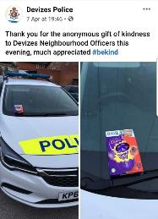
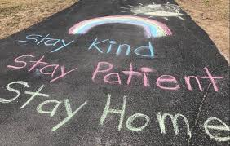
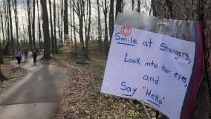
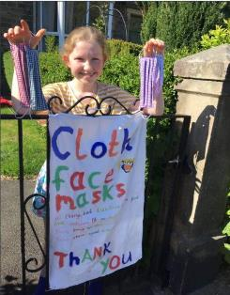
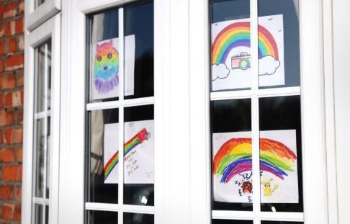
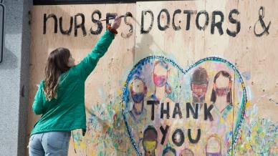
Sleep
In these difficult times, acts of kindness are connecting people and communities.
A state of rest in which the eyes are closed, the body is inactive and the mind does not think.
Finally, see HERE for news report about acts of ‘coronakindness’
The 2020 for Mental Health Awareness Week says…
to public messages of encouragement.
A new community library box.
To 1 million NHS volunteers.
From wall, window to pavement thank yous.
Another community honouring keyworkers with 30 effigies .
Neigbours in cars to celebrate a couple’s wedding.
Chocolate left for police, to face masks.
#5. Practice kindness.
People are coming together to sing on balconies or clap keyworkers. Others are setting up groups offering support to the vulnerable, like collecting shopping, etc.
Helping other people can make you and them feel better.
Notes:
https://www.mind.org.uk/need-urgent-help/what-can-i-do-to-help-myself-cope/relaxing-and-calming-exercises/
https://www.youtube.com/watch?v=1NZdzg09wXQ

Slide 10
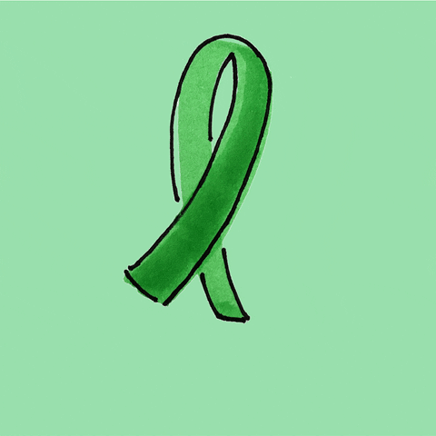
Thought for the Week is written to promote, encourage and foster your Spiritual, Moral, Social and Cultural learning.

Slide 11
Helping others feels good and evidence shows physiological changes in the brain linked with happiness.
Helping others encourages us to be more active and this in turn can improve our self-esteem.
It creates a sense of belonging and reduces isolation.
It helps keep things in perspective. Helping others, especially those who are less fortunate than yourself, can help to put things into perspective and make you feel more positive.
It helps make the world a happier place – the virus isn’t the only thing which is contagious! Acts of kindness have the potential to make the world a happier place.
It may also encourage others to repeat the good deed that they’ve experienced themselves – contributing to a more positive community.
https://www.mentalhealth.org.uk/coronavirus/random-acts-kindness
Notes:
https://www.mentalhealth.org.uk/coronavirus/random-acts-kindness

