Slide 1
Belonging
“A deep sense of love and belonging is our universal need.”
Brene Brown (b.1965)

Slide 2
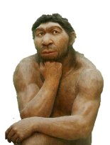
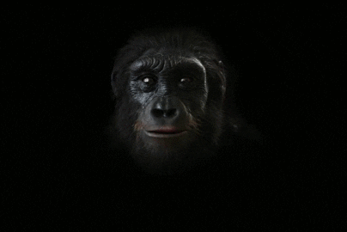
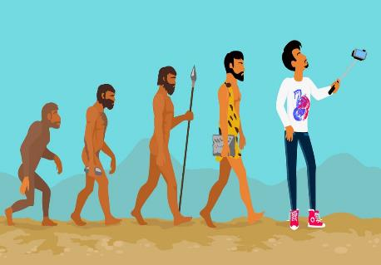
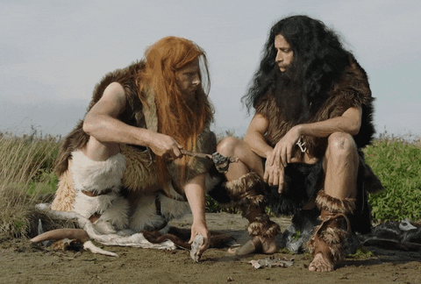
Belonging
Today we think of ourselves as less dependent on others for our food, safety and survival.
Keyworker
The desire we have for belonging reaches far back into our evolutionary, ancestral past...
Key word
.
An employee who provides a service vital to society (in time of need).
Being comfortable and happy in a place, situation or with people.
such
an
Individual!
Etymology:
Old English: langian
‘ to desire’ or ‘to reach for something.’
Although, as recent events remind us, there are times we still rely on our clan or tribe.
He’s
It’s all about the selfie i.e. ‘me!’
Name 10 keyworkers that people rely on for their food, safety and survival, during the lockdown.
…when belonging to a clan or tribe meant food, safety and survival.

Slide 3
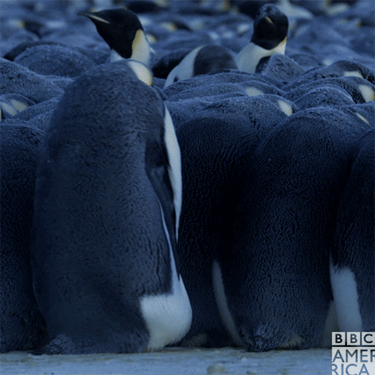
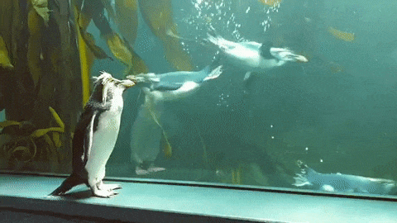
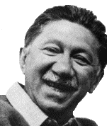
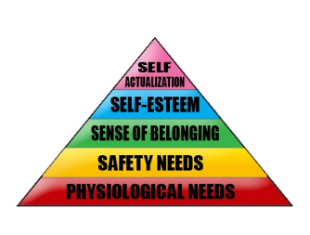
Belonging
You may have heard the phrase “having (seeking or lacking) a sense of belonging.”
It is 3rd in the famous Hierarchy of Needs, of psychologist, Abraham Maslow (d.1970)
Being comfortable and happy in a place, situation or with people.
Rejected, lonely, isolated… a weirdo?
What exactly is it you are ‘sensing’ when belonging?’
Etymology:
Old English: langian
‘ to desire’ or ‘to reach for something.’
What might we be feeling when we lack a ‘sense of belonging?’
Belonging is the important emotional need of feeling accepted, valued, supported, respected and connected, in places, situations or with people.

Slide 4
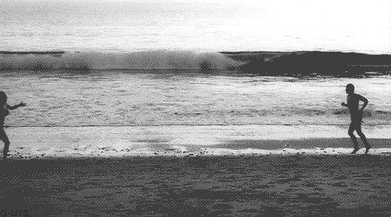
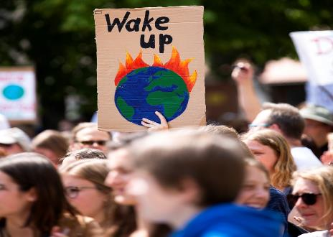
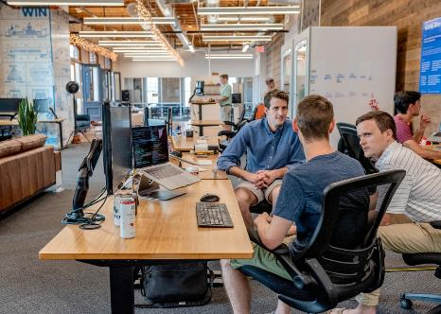
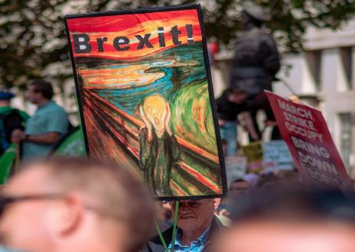
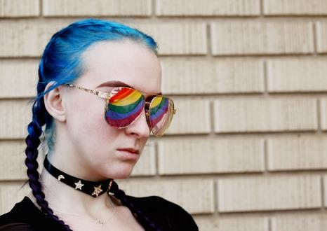
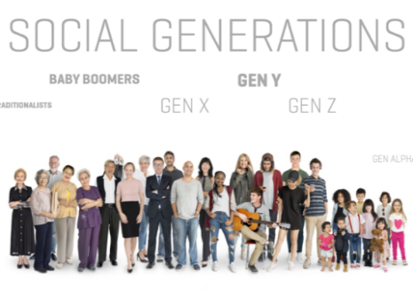
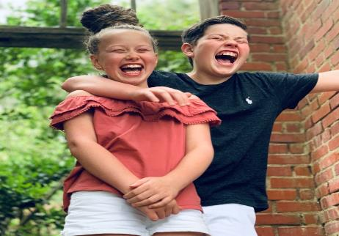
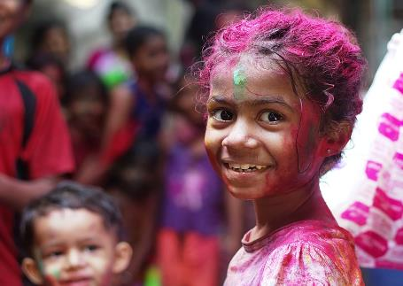
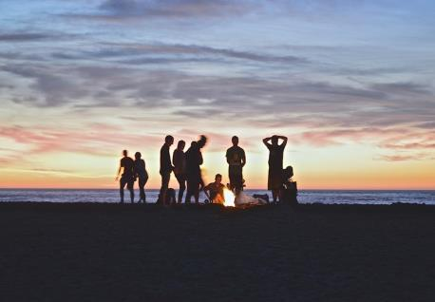
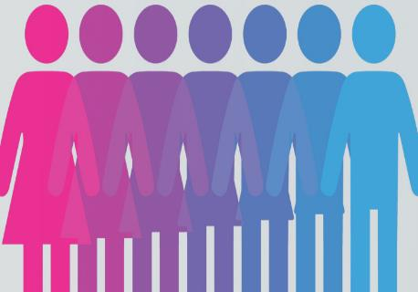
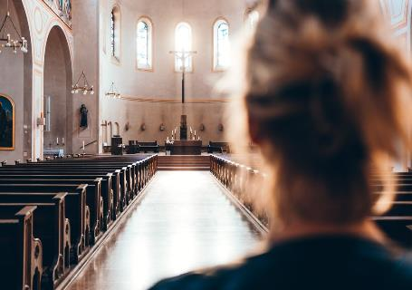
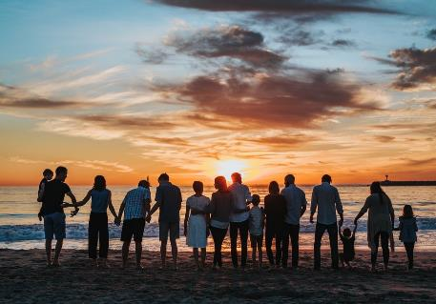
Belonging
So, where do we find this ‘sense of belonging’ in our everyday lives?
Of course, we can also feel a powerful lack of belonging in these areas of our lives too.
Feeling accepted, valued and supported in places, situations or with people.
Etymology:
Old English: langian
‘ to desire’ or ‘to reach for something.’
“Ships are safe in the harbour, but that’s not what they’re built for.”
We can find belonging in sharing, or holding in common, the following…
Interests and experiences
Family
In both cases, belonging is known to have a significant impact on our physical and mental wellbeing.
Gender
Values and beliefs
Culture and upbringing
Sense of humour
Love and intimacy
Sexuality
Politics
Age or generation
Aspirations
Purpose
Work and careers

Slide 5
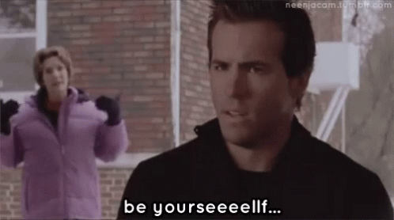
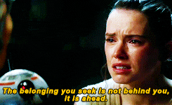
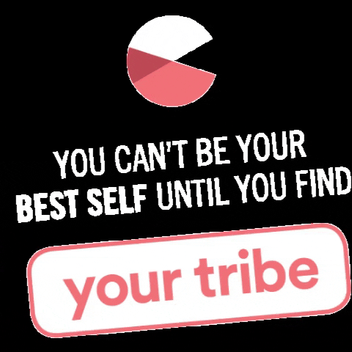
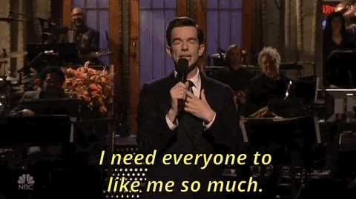
Belonging
Belonging is a powerful motivator that can protect us against stress and anxiety.
Feeling accepted, valued and supported in places, situations or with people.
Etymology:
Old English: langian
‘ to desire’ or ‘to reach for something.’
Considering its importance, what can we do to promote a sense of belonging?
1. Be yourself, everyone else is already taken!
2. Find your own tribe, not someone else's.
3. Stop trying to please everyone all the time.
Accepting yourself can increase the likelihood of you being in the places, situations and among the right people to foster your sense of belonging.
You don’t need to change yourself to ’fit in.’ If you find your ‘tribe,’ you will feel belonging because of the values and interests that you share.
When we judge others less, we feel less judged. If we want to feel accepted, be more accepting of others.
4. Look to the similar not the different.
The desire for a sense of belonging can make us people pleasers, which can separate us from a sense of belonging.
Notes:
https://www.learning-mind.com/sense-of-belonging-happy/

Slide 6
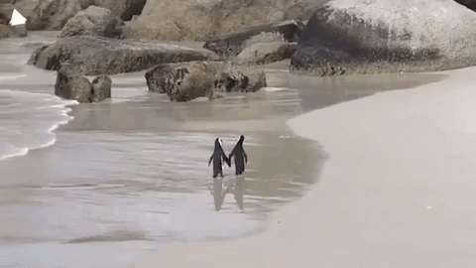
Thought for the Week is written to promote, encourage and foster your Spiritual, Moral, Social and Cultural learning.

