Slide 1
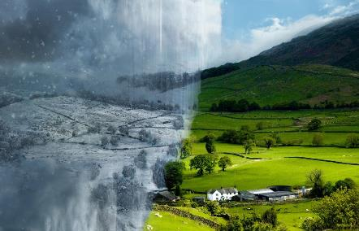
Equanimity
“Victory and defeat are to be viewed with equanimity.”
Atal Bihari Vajpayee (d.2018)
Notes:
“Victory and defeat are to be viewed with equanimity.”
Atal Bihari Vajpayee (d.2018)

Slide 2
Equanimity
Mental calmness in
difficult situations.
Etymology
Latin: aequanimitas
aequus ‘equal’ animus ‘mind’

Slide 3
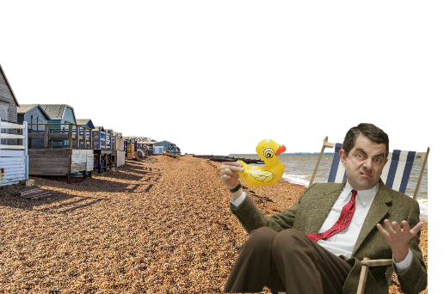
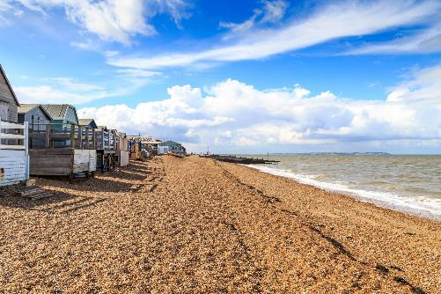
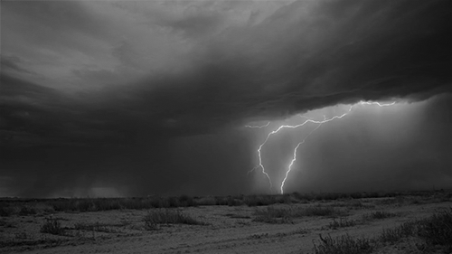
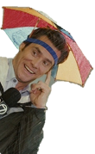
Equanimity
Equanimity is a state of mind that can be at peace in both the pleasant and unpleasant.
Our thoughts and emotions can be as changeable as this May’s weather.
Mental calmness in
difficult situations.
Etymology
Latin: aequanimitas
aequus ‘equal’ animus ‘mind’
Idiom
Key word
A phrase or expression.
Can you think of any synonyms or idioms for equanimity?

Slide 4
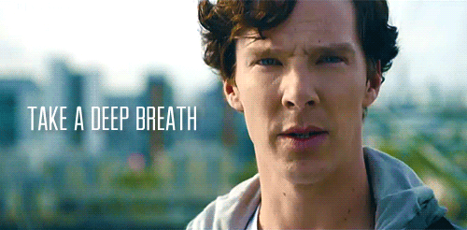
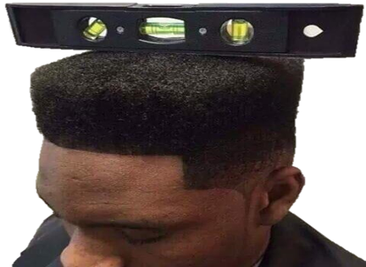
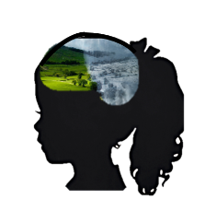
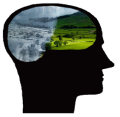
Equanimity
You may have thought of the following synonyms and idioms for equanimity…
Mental calmness in
difficult situations.
Composure
Calmness
Self-control
Even-temper
Coolness
Stay cool.
Keep a level-head.

Slide 5
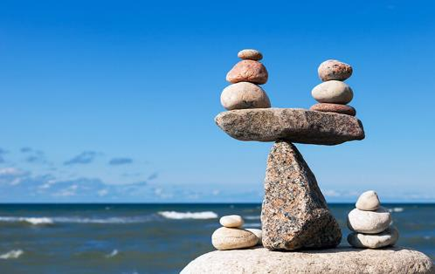
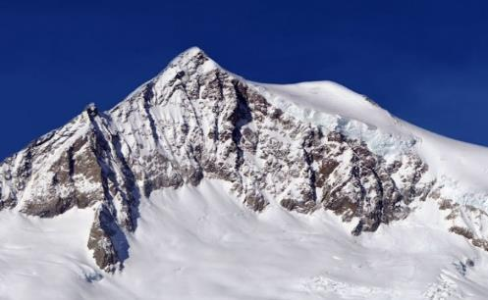
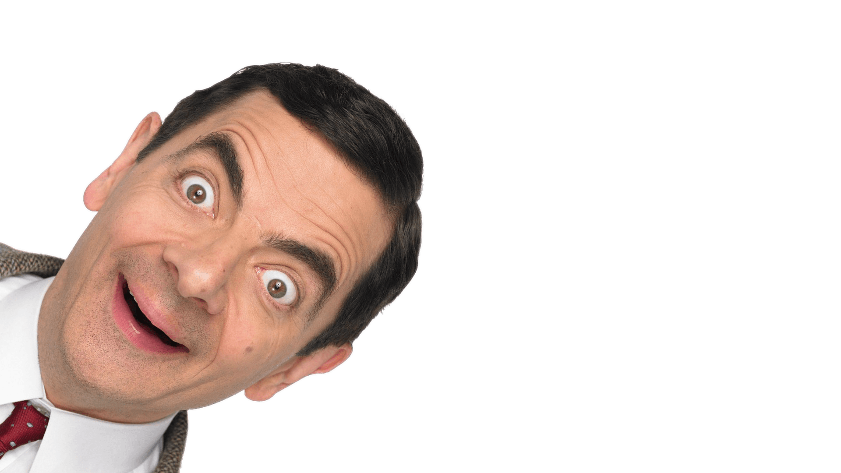
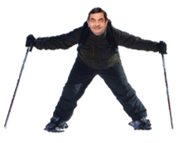
Equanimity
Here’s another popular image for equanimity. What might it suggest about equanimity?
Equanimity is often likened to a mountain.
Mental calmness in
difficult situations.
A mountain absorbs the sun as it does the rain, wind and snow. No matter what is going on around it, the mountain remains a mountain.
Equanimity is a matter of balance.
Likewise, people who show equanimity remain even-tempered and unaffected by outside influences.
In what way might equanimity be like a mountain?

Slide 6
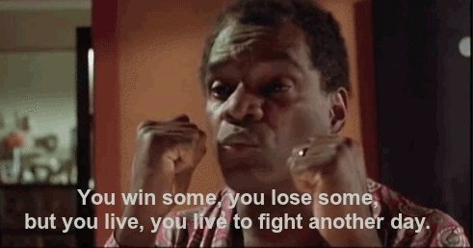
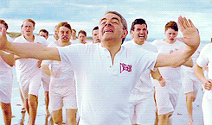
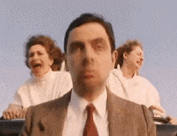
Equanimity
Life is a rollercoaster ride of ups and downs, of…
success and happiness
+
failure and despair.
Mental calmness in
difficult situations.
Equanimity helps us both accept and cope with the ups and downs of living a human life.
Little wonder that the quality of equanimity is so highly valued in religion, philosophy and psychology.

Slide 7
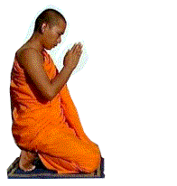
Equanimity
In Buddhism, in particular, equanimity (or ‘upekkha’) is one of The Four Great Virtues.
Mental calmness in
difficult situations.
BTW, what do you think Sympathetic Joy might mean?
The Four Virtues
Loving Kindness – ‘metta’
Compassion- ‘karuna’
Sympathetic Joy – ‘mudita’
Equanimity – ‘upekkha’
Virtue
Schadenfreude
Cultivate
Key word
Key word
Key word
Thinking and doing what is right and avoiding what is wrong.
German, meaning ‘pleasure in the misfortune of others.’
To grow, develop or nurture.
Finding happiness in the good fortune of others.
The following insights from religion, philosophy and psychology, suggest ways in which we might go about cultivating equanimity…
Its opposite is jealousy or schadenfreude.

Slide 8
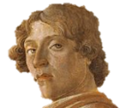
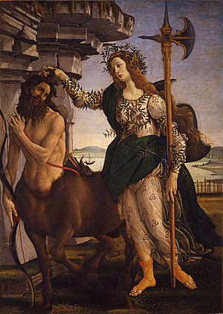
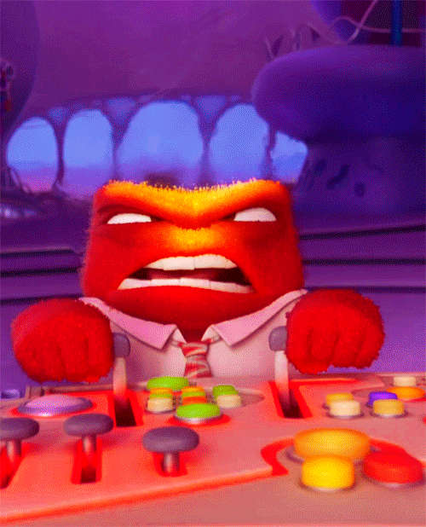
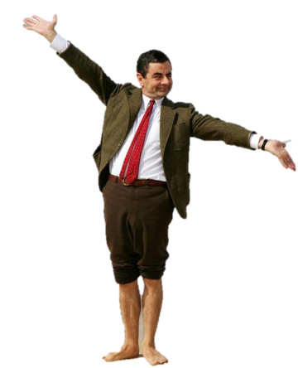
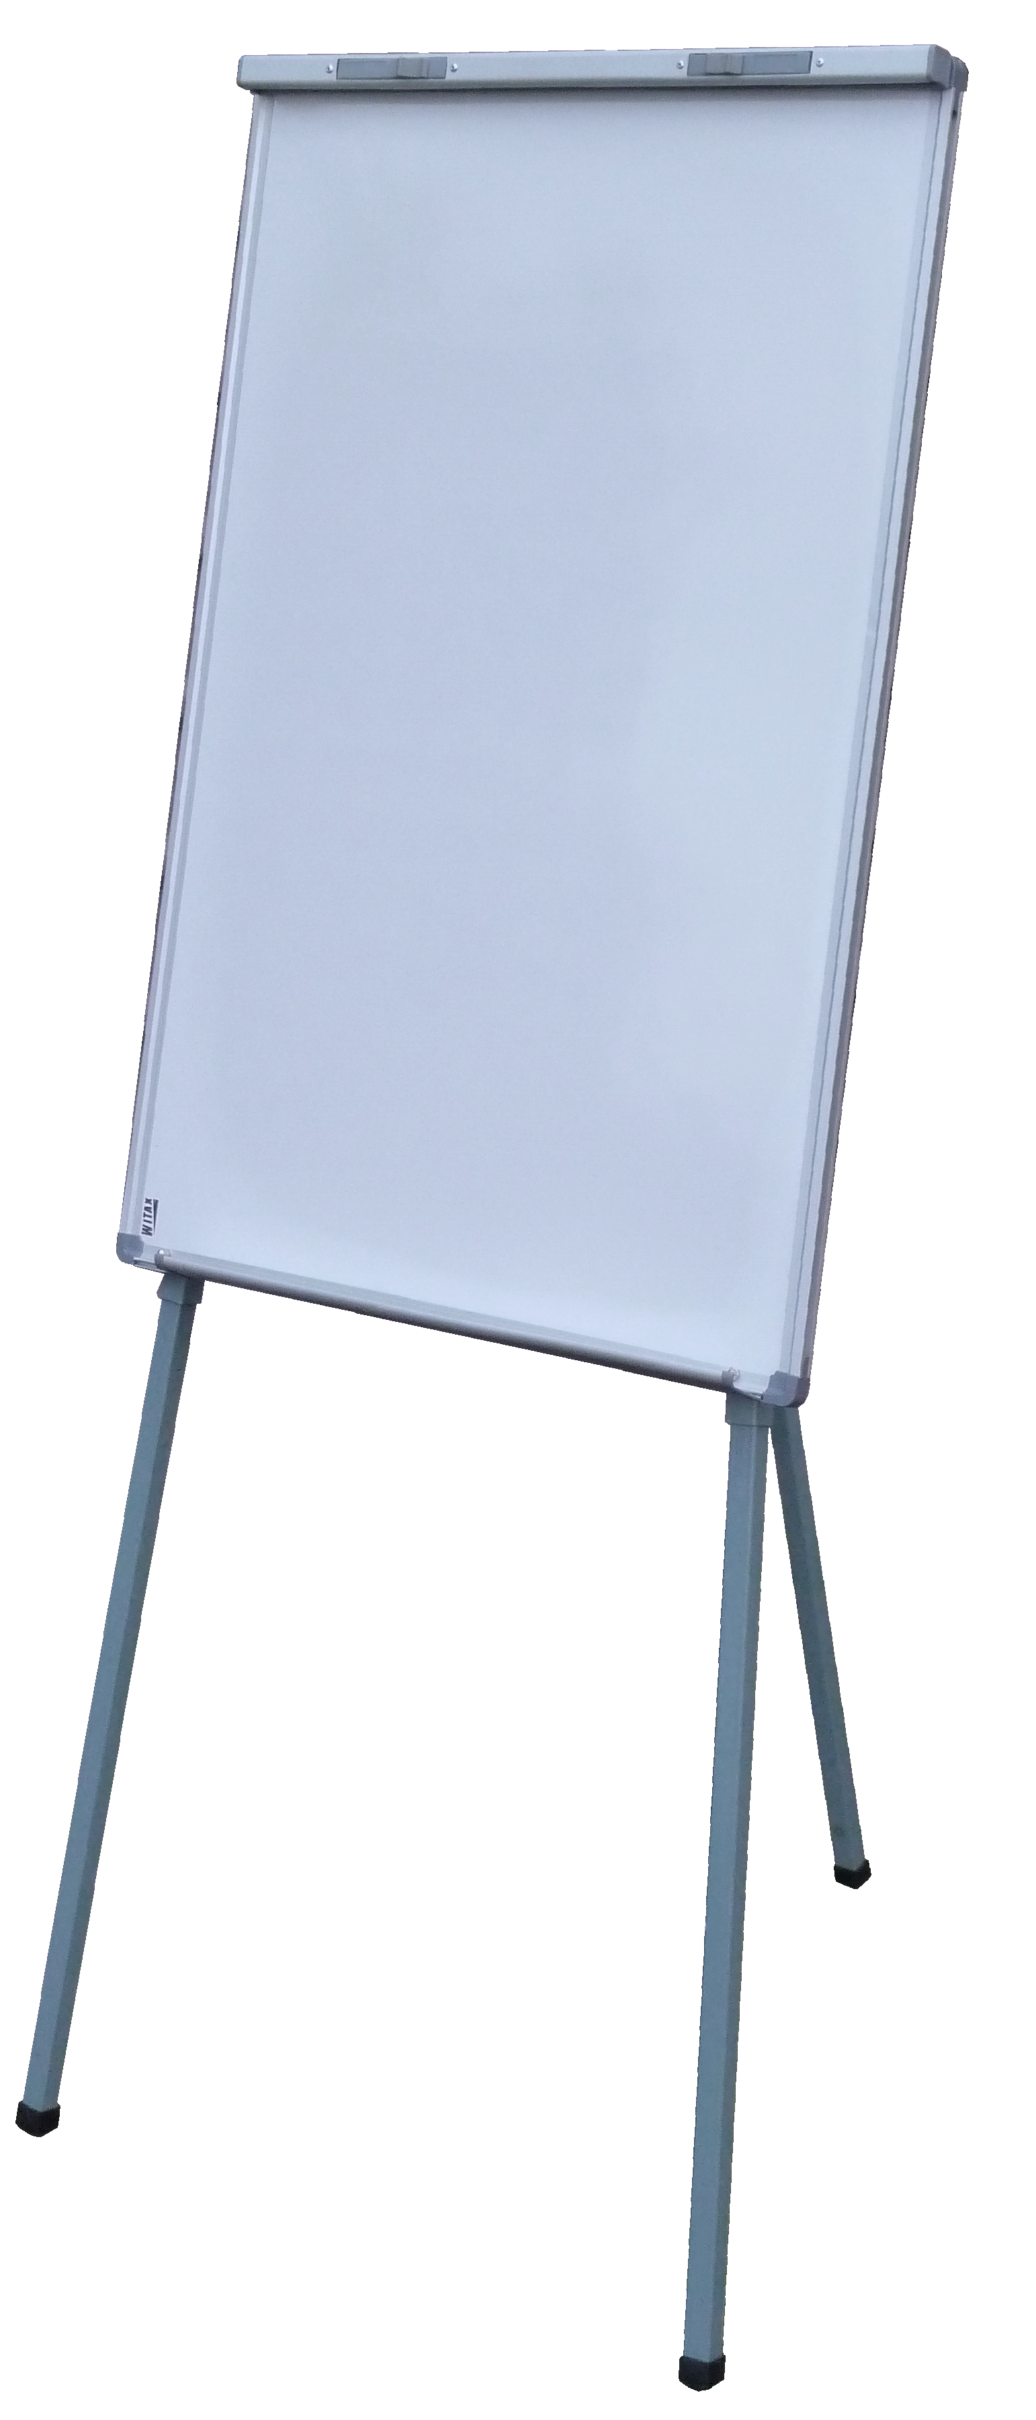
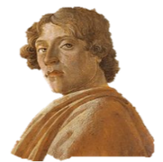
Equanimity
Being better at managing emotions means we will be less reactive and more responsive to our feelings.
Mental calmness in
difficult situations.
What is the difference between reactive and responsive?
Wisely managing!
Me, Sandro Botticelli (d.1510).
It’s called Athene and the Centaur.
Which would be reactive, which responsive?
1.
Manage
emotions
What is Athene doing in the picture?
The following insights from religion, philosophy and psychology, suggest ways in which we might go about cultivating equanimity…
Reactive is a ‘knee-jerk’ or ‘hot-headed’ reaction. Useful in some situations but destructive in others.
Renaissance
Athene represents human wisdom.
The centaur (half man half animal) often represents human emotion.
Can you name the renaissance artist who painted this picture?
How might managing emotions cultivate equanimity?
Key word
A period in history beginning around 1400, in Europe.
Notes:
https://neelraman.com/10-characteristics-of-level-headed-people-that-will-make-you-powerful/
https://www.psychologytoday.com/intl/blog/turning-straw-gold/201105/how-cultivate-equanimity-regardless-your-circumstances

Slide 9
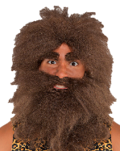
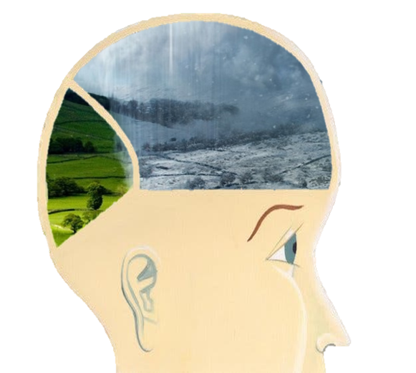
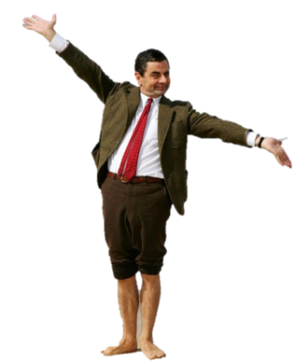
Equanimity
Finding the positives can bring a sense of balance when things aren’t going as well as we hoped.
Mental calmness in
difficult situations.
Because 1000s of years ago we depended on this to survive.
Epic fail!
2.
Find the positives.
What positives have you found when things haven’t gone well for you?
This does not always come easy, as our minds are hard-wired to focus on the bad.
Notes:
https://www.psychologytoday.com/us/blog/hope-relationships/201409/6-ways-become-more-positive-today

Slide 10
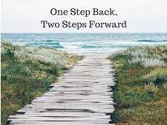
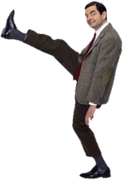
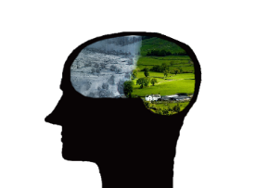
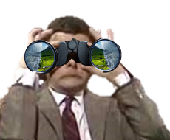
Equanimity
One practice you can do when trying to find positives is the One Step Back, Two Steps Forward method...
Mental calmness in
difficult situations.
Then take a moment to counter each negative thought or feeling with two positive ones.
2.
Find the positives.
Simply observe your thoughts and feelings.
See if you can catch yourself focusing on failures, complaining or criticising yourself, or others.
Notes:
https://www.psychologytoday.com/us/blog/hope-relationships/201409/6-ways-become-more-positive-today

Slide 11
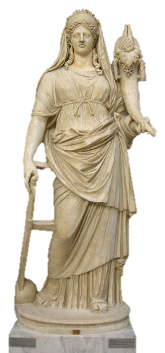
Equanimity
‘Letting go’ of trying to control what is not in our control gives us a greater sense of acceptance in life.
Mental calmness in
difficult situations.
Er, like changeable weather.
Er, a lack of sunshine!
How might an acceptance that there are influences outside our control, cultivate equanimity?
3.
Let Go!
You are
not always in control!
Or change in general.
…cause you an unevenness of mind?
The ancient goddess, Fortuna, represents good or bad luck. With her left hand she bestows gifts and with her right moves a rudder, controlling lives.
What examples can you give of things which are not in your control, which frustrate you and…

Slide 12
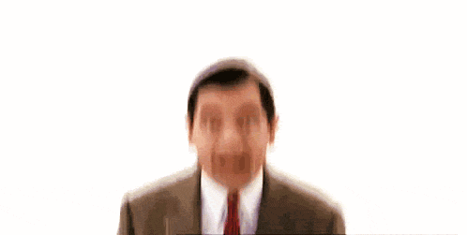
Equanimity
So, increase your equanimity by ‘managing emotions’, ‘finding positives’ and by ‘letting go’…
to
Mental calmness in
difficult situations.

Slide 13
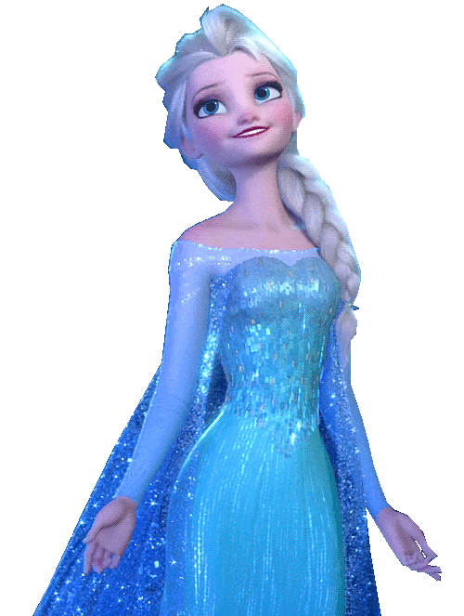
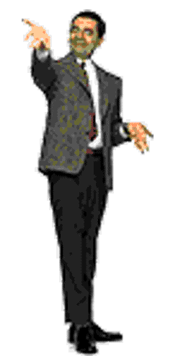
T4tW is written to promote, encourage and foster your Spiritual, Moral, Social and Cultural learning.

