Slide 1
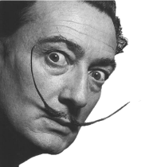
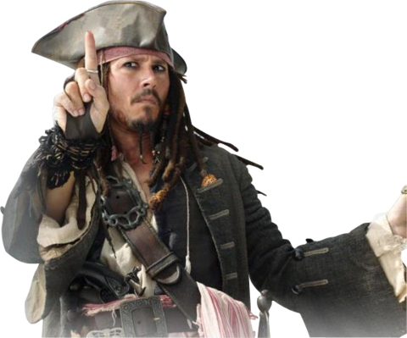
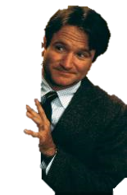
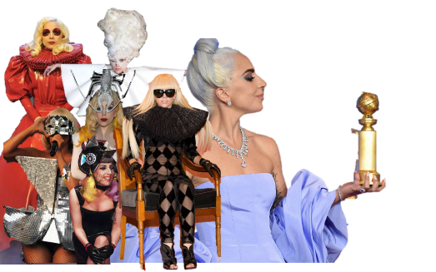
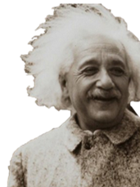
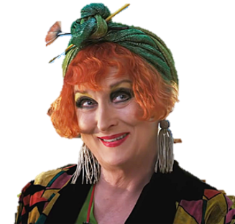
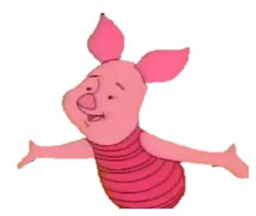

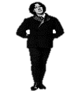

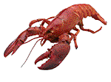
Idiosyncratic
“The things that make me different are the things that make me.”
A. A. Milne (d.1956)

Slide 2




Idiosyncratic
Considering synonyms can also help you get your head around the meaning of a word.
Exploring the etymology of a word can often help you understand its meaning.
adjective
A person or behaviour with
unique or individual characteristics.
Etymology: Greek idiosynkrasia
There are 3 root-words in idiosyncratic.
Idio ‘one’s self’
syn ‘ together’
krasia ‘mixed’
Can you identify these parts and what they might mean?
Eccentric
Odd
Quirky
Peculiar
Special
What synonyms can you think of for idiosyncratic?
Life
Synonym
Life
Root-word
Key word
Etymology
Key term
Key word
A word meaning exactly or nearly the same as another word.
Part(s) of a word
which carry its meaning.
The ‘true study’ of the origins of words.
Notes:
https://www.etymonline.com/word/idiosyncrasy

Slide 3

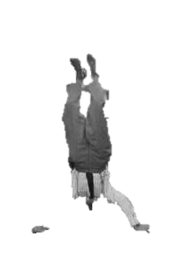

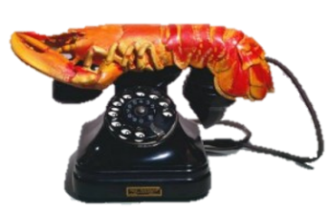
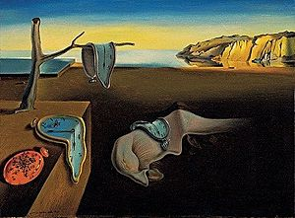
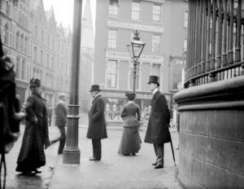
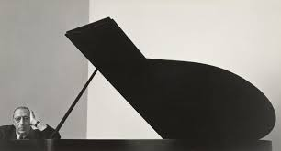
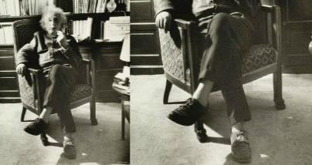
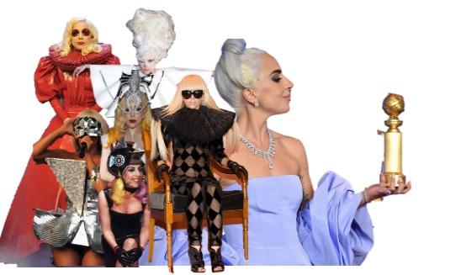
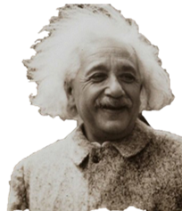
Idiosyncratic
“The amount of eccentricity in a society is proportional to the amount of genius.”
A person can be idiosyncratic in their appearance, behaviour or attitudes.
adjective
Hey, what about me? I created the lobster telephone.
A person or behaviour with
unique or individual characteristics.
Life
Ostentatious
Life
Surreal
It helped me write music.
Is there a link between being idiosyncratic and being creative?
Key word
Key word
To attract or seek attention.
Having an unusual
or dreamlike quality.
I prefer his surreal painting The Persistence of Time.
Wrote the philosopher, John Stuart Mill (d.1873)
Like Einstein, who believed socks were as unnecessary as barbers.
The poet, Oscar Wilde (d.1900) used to take his pet lobster for walks.
The composer Igor Stravinsky (d.1971) spent part of his day on his head.
Ah, yes, the ostentatious artist, Salvador Dali (d.1989)
Or Lady Gaga, who is famously idiosyncratic in her appearance.
Notes:
https://www.indy100.com/article/geniuses-unusual-habits-albert-einstein-jane-austen-agatha-christie-beethoven-loenardo-da-vinci-8100936
http://listverse.com/2009/03/15/10-incredibly-eccentric-people/
https://i-d.vice.com/en_uk/article/mbdn54/how-our-perception-of-a-celebrity-changes-after-they-dye-their-hair

Slide 4
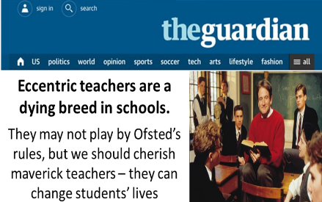
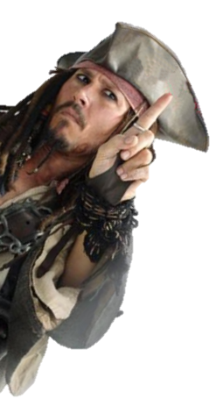
Idiosyncratic
Can you think of anyone you know who
has an idiosyncratic or eccentric character?
adjective
A person or behaviour with
unique or individual characteristics.
A teacher perhaps?
Watch this clip from the 1989 film Dead Poets Society…
Notes:
https://www.theguardian.com/teacher-network/2015/sep/26/secret-teacher-brilliant-eccentrics-are-a-dying-breed-in-education

Slide 5
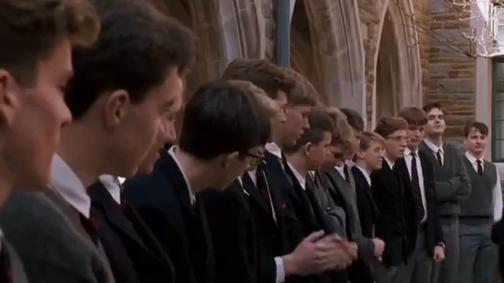

Slide 6
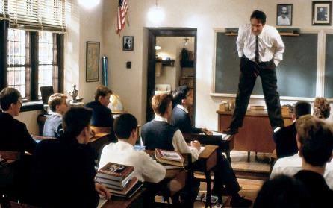
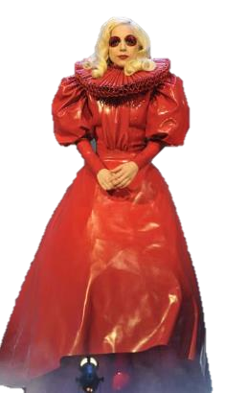

Idiosyncratic
Throughout the film, teacher, Mr Keating is unconventional in his teaching practice.
adjective
A person or behaviour with
unique or individual characteristics.
Humour?
His behaviour was nonconformist.
Originality
Life
Norms
Self-Belief
Key word
Something usual, typical or standard.
Courage
Risk
Daring
Imagination
What might the characteristics of idiosyncratic people include?
Life
Conventional
Key word
His attitude was outside the norms of what might be considered ‘normal’.
Life
Conform
A way in which something is usually done.
Key word
To follow with accepted rules.

Slide 7
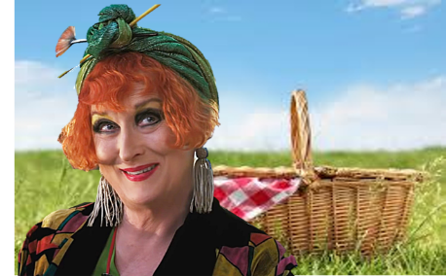
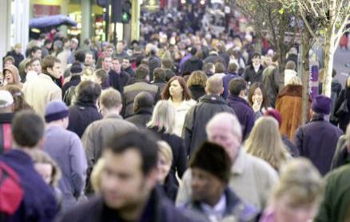
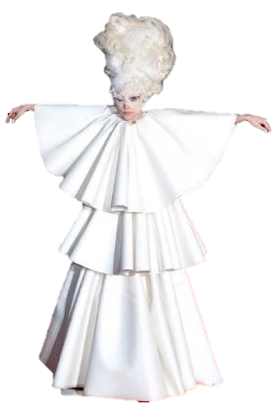
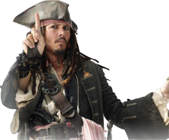
Idiosyncratic
“That so few people now dare to be eccentric is the chief danger of our time”
Are there fewer idiosyncratic people today?
adjective
A person or behaviour with
unique or individual characteristics.
The philosopher, John Stuart Mill further wrote…
Life
Values
Key word
Beliefs or ideas deemed desirable by people or culture.
Are today’s ‘norms’ or values incompatible with idiosyncrasy?
To what extent does the idiosyncratic person today risk being labelled unusual or strange?

Slide 8
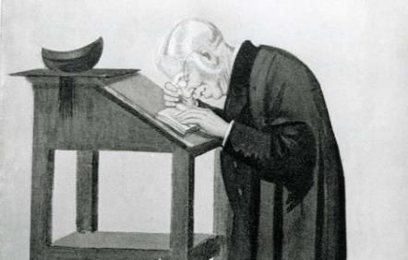
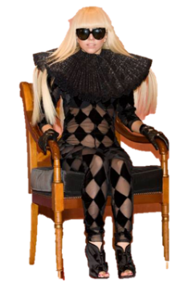
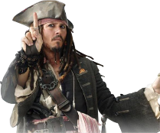
Idiosyncratic
William Archibald Spooner (d.1930) was
an idiosyncratic teacher whose tongue
barely kept up with his keen intellect.
adjective
A person or behaviour with
unique or individual characteristics.
Can you work out these spoonerism?
And in a speech to Queen Victoria…
Life
Spoonerism
Key word
You have wasted a whole term.
It is customary to kiss the bride.
I have in my bosom a half-formed wish.
The Lord is a loving shepherd.
Will nobody pick up my hat.
You will require a well-oiled bicycle.
Accidental (or intentional) swapping of letters in a sentence.
Of peculiar temper or disposition; belonging to one's peculiar and individual character.
“It is kisstomary to cuss the bride.”
“You have tasted a whole worm.” (to a lazy student).
Maybe you could try creating your own ‘spoonerisms’.
“Will nobody pat my hiccup?” (Upon dropping his hat).
“You will require a well-boiled icicle.”
”The Lord is a shoving leopard”
“I have in my bosom a half-warmed fish.”
.”
Students would attend his lectures just to hear him make a mistake. He became famous for what became known as ‘spoonerisms’.
Notes:
https://www.telegraph.co.uk/books/authors/spoonerisms-best-spooner-lines/

Slide 9
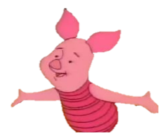
Idiosyncratic
William Archibald Spooner (d.1930) was
an idiosyncratic teacher who’s tongue
barely kept up with his keen intellect.
adjective
A person or behaviour with
unique or individual characteristics.
Can you recall this week’s Whought tor the feek quote?
“The things that make me different are the things that make me.”
A. A. Milne (d.1956)

Slide 10
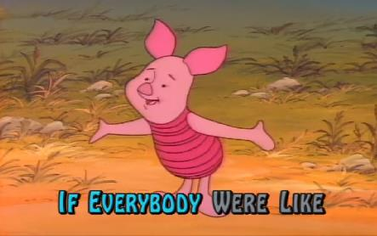
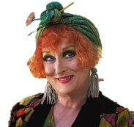
Idiosyncratic
Watch the following clip of Piglet
singing about his idiosyncrasies.
adjective
A person or behaviour with
unique or individual characteristics.
Identify where Piglet sings about idiosyncrasy...

Slide 11


Slide 12
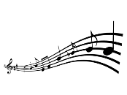



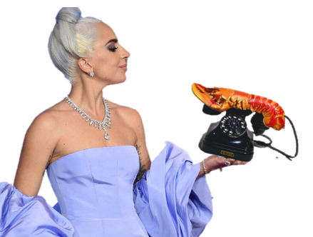
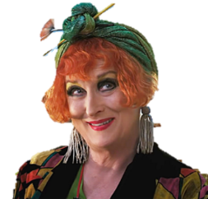
Idiosyncratic
Watch the following clip of Piglet
singing about his idiosyncrasies...
“If everyone were like everyone else how boring it would be.”
adjective
A person or behaviour with
unique or individual characteristics.
“The things that make me different…
…are the things that make me me.”
What did Piglet says about idiosyncrasy.
What are your idiosyncrasies?

Slide 13
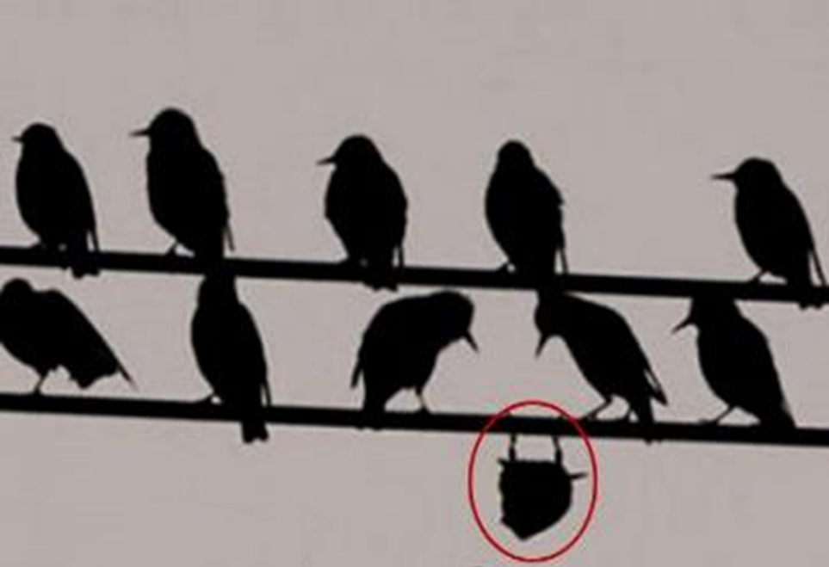
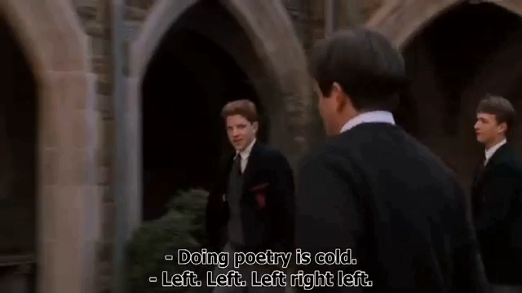

T4tW is written to promote, encourage and foster your Spiritual, Moral, Social and Cultural learning.

