Slide 1
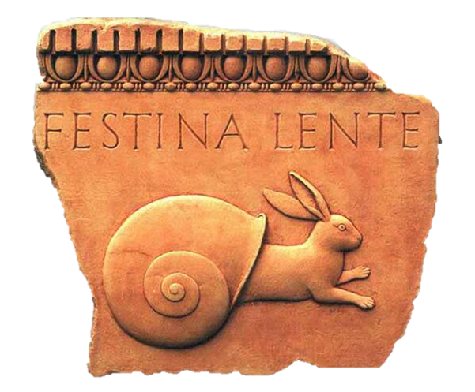
Oxymoron
“Make haste slowly.”
Roman Proverb

Slide 2
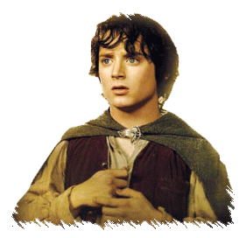
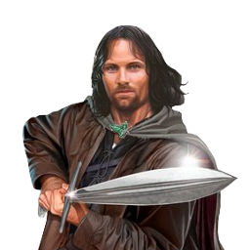
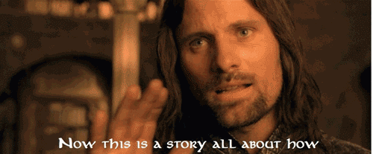
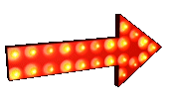
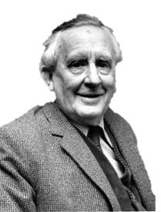
Oxymoron
Most words have little connection to the things they describe (beyond their etymology).
J.R.R. Tolkien, writer of Lord of the Rings, used to comment that his surname is an oxymoron.
The word oxymoron is autological, i.e. its etymology is itself an oxymoron.
A word or phrase
which contradicts itself.
e.g.
Yellow
Etymology:
Latin: oxymōrum
meaning ‘sharp-dull’
Name some heterological words yourself.
Such words are known as heterological words.
Square
There’s actually not all that many of these words.
Most words are heterological.
Can you think of any autological words, like oxymoron?
‘Tolkien’ comes from an old German word ‘toll-kühn’
Life
Autological
Life
Heterological
Key word
Key word
The word ‘yellow’ is not actually yellow. The word ‘square’ is not a square.
Which means, ‘dull-keen.’
Words which do not describe themselves (the opposite of autological).
A word which describes itself.

Slide 3
Oxymoron
Most words have little connection to the things they describe (beyond their etymology).
A word or phrase
which contradicts itself.
Pentasyllabic
Heterological
Sesquipedalian
Unhyphenated
Monopic.
Noun
Word
English
This next one will blow your mind…
pen-ta-si-lab ik
Well it’s not French is it!
Yup, that’s it, in a ‘word’!
It has five syllables. ‘Penta’ means ‘five.’
A word for ‘a long word’ from the Latin for ‘a foot and a half long.’
‘Verb’, ‘adjective’, and ‘adverb’ are nouns too!
A sentence with one word.
Is the following word autological or heterological?
Life
Autological
Key word
Explain why the following words are autological…
A word which describes itself.

Slide 4
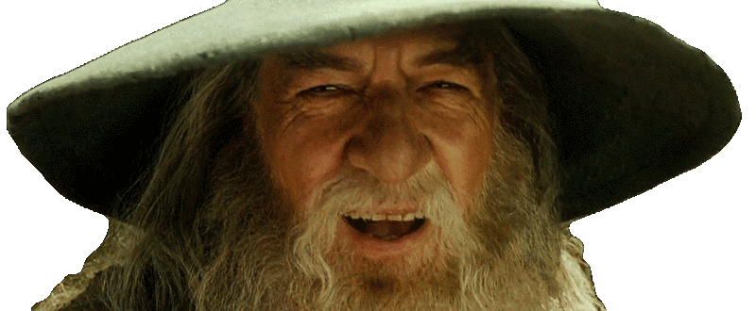
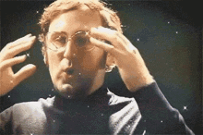
Oxymoron
A heterological word, like yellow or square, does not describe itself.
A word or phrase
which contradicts itself.
If yes, then by definition it’s autological, so then it doesn’t describe itself.
Is it blowing your mind? Welcome to what is known as the Grelling-Nelson Paradox.
Heterological
So does the word ‘heterological’ describe itself?
Life
Heterological
Life
Grelling-Nelson
Paradox
Key word
Key word
But if no, then ‘heterological’ is heterological, therefore it actually does describe itself, which means it’s autological!
Words which do not describe themselves (the opposite of autological).
Meaning the answer to the question results in a contradiction.
Notes:
https://en.wikipedia.org/wiki/Grelling%E2%80%93Nelson_paradox

Slide 5
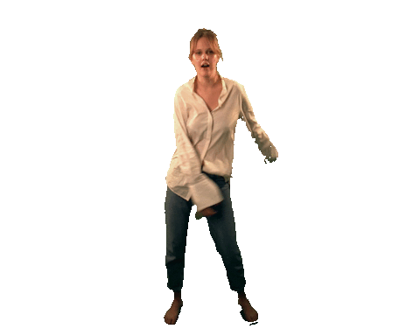
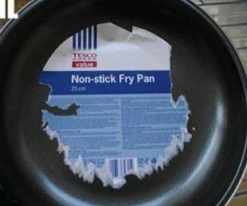
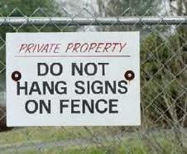
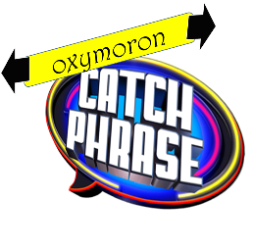
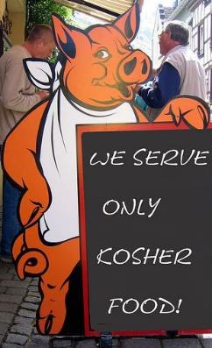
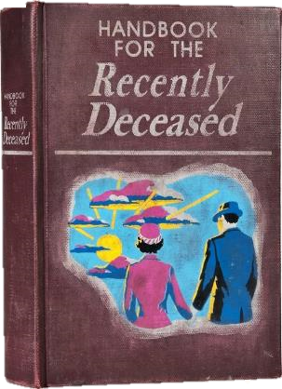
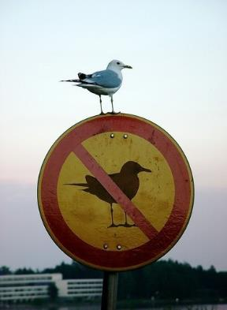
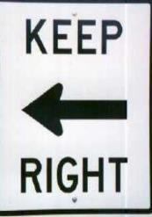
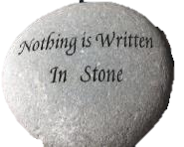
Let’s play a game of….

Slide 6
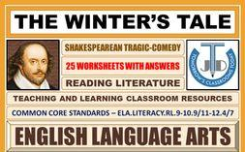
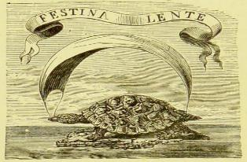
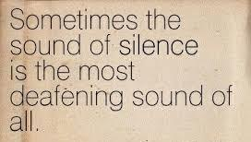
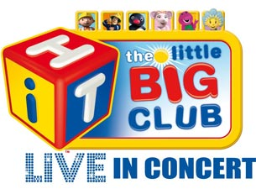
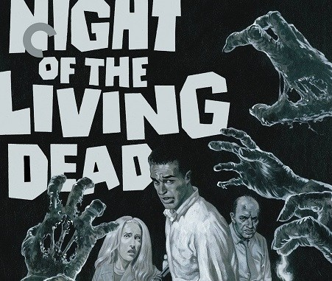
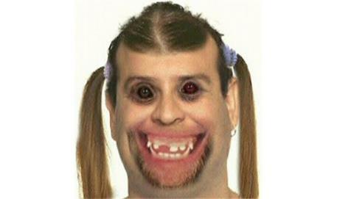
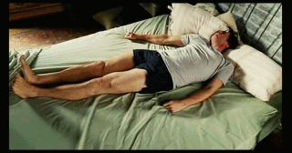
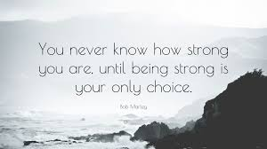
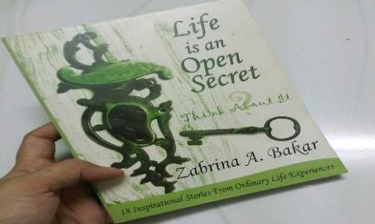
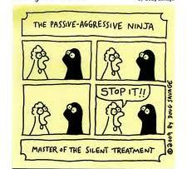
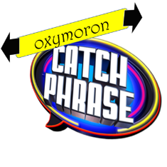
Oxymoron
Identify the oxymoron word or phrase?
A word or phrase
which contradicts itself.
“Still moving”
“Passive aggressive”
“Open secret”
“Pretty ugly”
“A small crowd”
“A little big”
“Restless sleep”
“Paid volunteer”
“Deafening silence”
“Seriously funny”
“Only choice”
“Living dead”
“Tragic comedy”
“Virtual reality”
“Make haste slowly”
Say what you see!

Slide 7
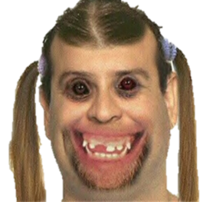
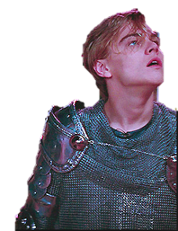
Oxymoron
Writers often use oxymoron by combining two things that are opposites, for dramatic effect.
A word or phrase
which contradicts itself.
13
O brawling love! O loving hate! O anything of nothing first create! O heavy lightness, serious vanity! Misshapen chaos of well-seeming forms! Feather of lead, bright smoke, cold fire, sick health! Still-waking sleep, that is not what it is! This love feel I, that feel no love in this.]
How many can you see?
In Shakespeare's Romeo and Juliet, Romeo uses a string of oxymorons to express his feelings about the fine line between love and hate.
Notes:
Shakespeare, William. "Act 1, Scene 1". Romeo and Juliet.
https://www.enotes.com/homework-help/what-romeos-oxymorons-speech-show-romeo-juliet-345842

Slide 8
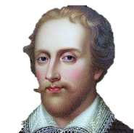
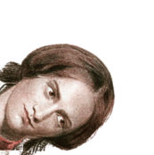
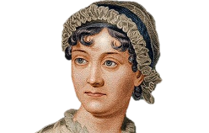
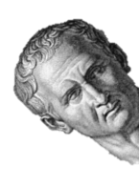
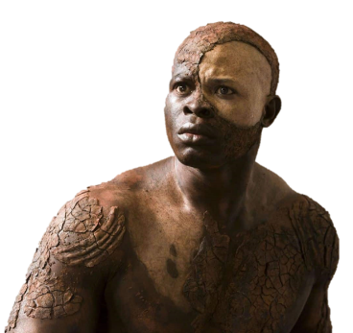
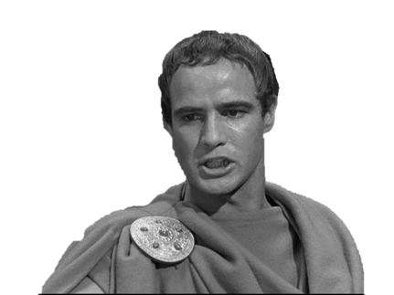
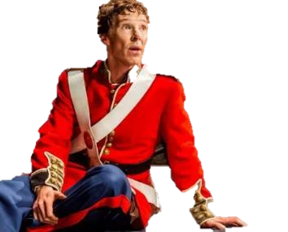
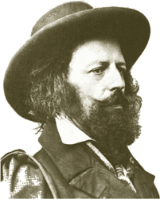
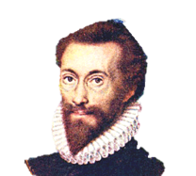
“Proud humility”
Spenser
Oxymoron
Shakespeare used oxymorons elsewhere…
And other writers too…
A word or phrase
which contradicts itself.
“Angry pleasure”
Jane Austen
“When they are silent they cry out”
Cicero
“I must be cruel only to be kind”
Hamlet. Hamlet
“Delicious poison”
Jane Eyre, describing love.
Charlotte Bronte
“Fearful bravery”
Mark Anthony. Julius Caesar
“Good mischief”
Caliban. The Tempest
“Falsely true”
Tennyson
“Beggarly riches”
John Donne

Slide 9
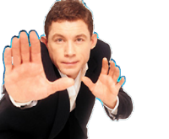
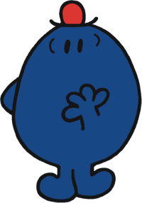
Oxymoron
Have a go at making up some oxymorons yourself, working independently in pairs!
A word or phrase
which contradicts itself.
I'm not going to say, “I told you so.”
My jokes are not to be laughed at!
See you next week with the theme ‘Love.’
I distinctly remember forgetting that.
If I dropped dead now, I'd be the happiest person alive!

Slide 10
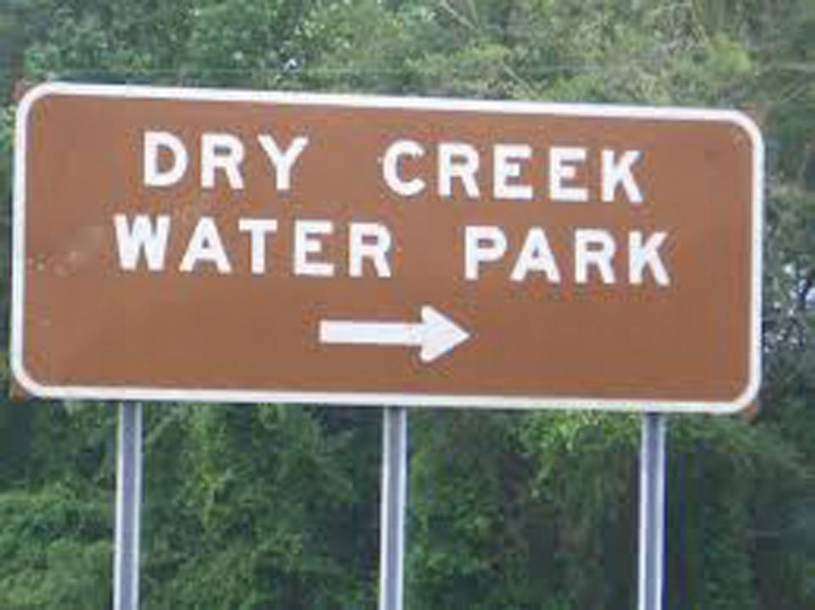
T4tW is written to promote, encourage and foster your Spiritual, Moral, Social and Cultural learning.

