Slide 1
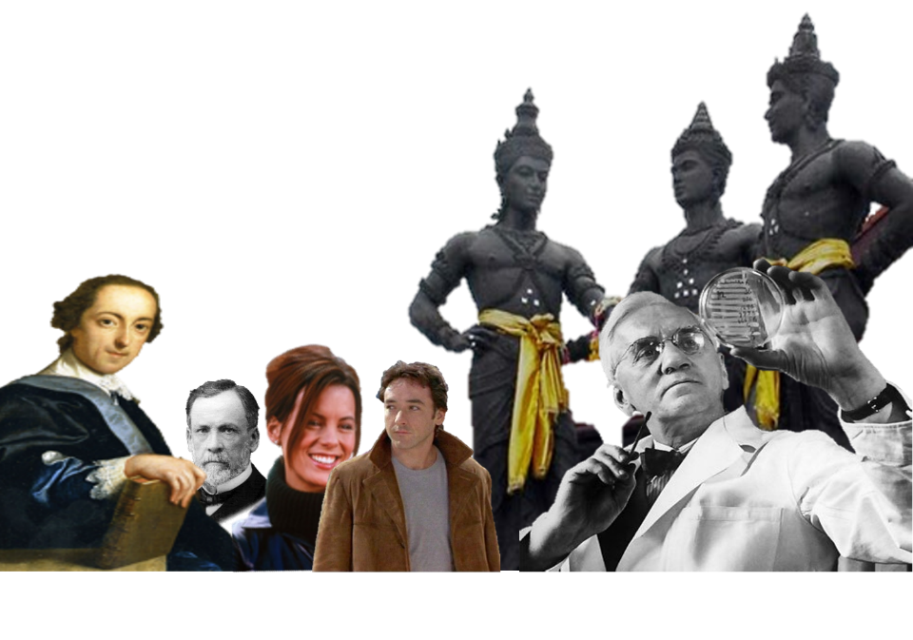
Serendipity
“Most discoveries even today are a combination of serendipity and searching.”
Siddhartha Mukherjee (b.1970)

Slide 2
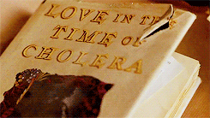
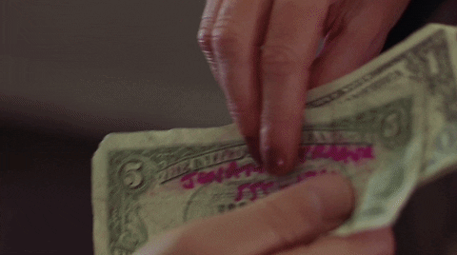
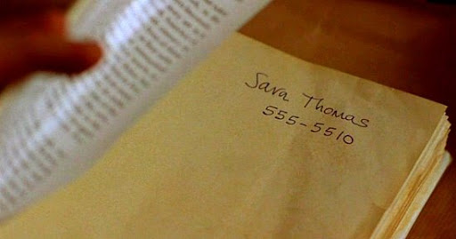
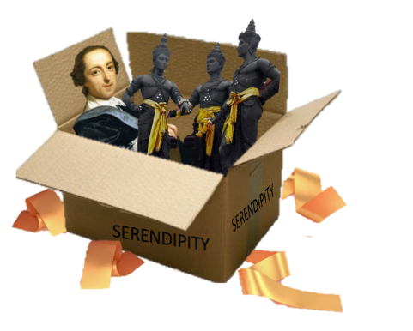
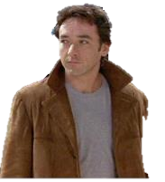
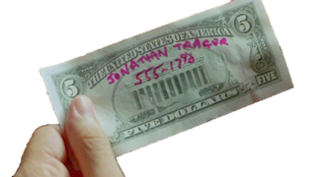
Serendipity
In everyday use, serendipity commonly refers to a happy coincidence, chance event or ‘fate’.
And they serendipitously meet again.
In the 2002 film, Serendipity a couple believe that their chance meetings are the work of fate.
We need to unpack serendipity a little more…
Accidently finding something good that you have not been looking for.
Stop you must!
If it was meant to be, we will serendipitously find the note and book.
Many feel it is a sign that something is ‘meant to be.’
3 years later, I find the $5 note.
Fate
Key word
A supernatural power which determines events in a person’s life.
We test these seemingly fated events. I write my phone number on a $5 note and she writes hers inside a book that is given to a bookshop.
And I find the book…
Serendipity is more than happy coincidence, chance event or a fated ‘meant to be.’
Like a series of chance romantic encounters with a stranger…

Slide 3
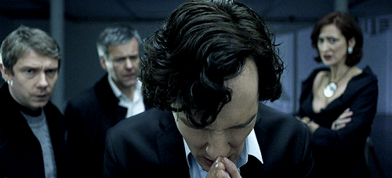
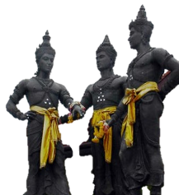
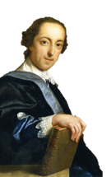
Serendipity
Together the princes were the Sherlocks of their day: discerning, intelligent and observant.
The word serendipity was created by writer and politician, Horace Walpole (d.1797).
Phenomenon
Sagacity
Key word
Key word
A situation that happens without cause or explanation.
The ability to make good judgements.
Accidently finding something good that you have not been looking for.
Etymology:
‘Serendip’ meaning ‘golden sands’
An ancient name for Sri Lanka.
Walpole said “these princes were always making discoveries by accident and sagacity.”
I wrote to a friend describing the phenomenon of chance discoveries.
Here’s a famous example of serendipity…
I created the word serendipity to describe both an accidental event and the intelligence to discover something good in the event.
He called the phenomenon ‘serendipity’, named after a fairy tale he’d read called, The Three Princes of Serendip.
Notes:
https://douglasbgibson.tumblr.com/post/136909913059/serendipity

Slide 4
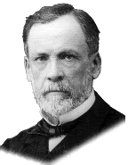
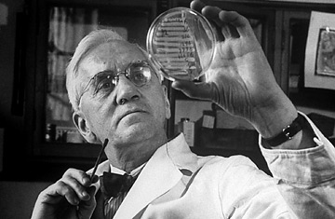
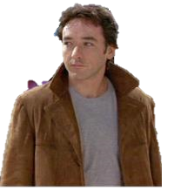
Alexander Fleming one day came home to find petri dishes filled with a bacteria killing mold.
Serendipity
Accidental chance findings happen, but serendipity requires us to act on it.
Nothing came of it but it probably made him take more notice of strange bacterial events.
Fruition
Btw, other scientists had recorded such mold in their experiments, but chose to ignore it.
Key word
The realisation of a plan or idea.
Accidently finding something good that you have not been looking for.
Research other famous examples of serendipity in science.
“Chance favours the prepared mind.”
Years earlier, Fleming had studied bacteria which had been contaminated by his nasal drippings, in the hope it would have a medicinal value.
…was it simply a happy coincidental chance event that was meant to be?
And consider if there might also be other influences, like past experience, important to the discovery.
Hence, serendipity can often be the fruition of past events too.
For as scientist, Louis Pasteur said…
So what had prepared Fleming’s mind for such a chance event?
Arguably it was both. That’s what I call serendipity.
Identify the ‘accident’ and ‘sagacity’ that make it a serendipitous discovery.
His scientific background?
But other scientific minds had chosen to ignore such mold.
17 years later that mold won him The Nobel Prize for Medicine, for his discovery of penicillin. It has since saved c.200 million lives.
Or was it Fleming’s intellect, openness and curiosity that saw the mold’s potential?
And science has made a career of acting on serendipity.
Notes:
https://www.morehouse.edu/academics/psychology/pdf/mrosenmann/Serendipity-And-Scientific-Discovery.pdf
http://www.bacteriainphotos.com/Alexander_Fleming_and_penicillin.html

Slide 5
Serendipity
So what about the fictional serendipitous romantic encounter between John and Sara?
Accidently finding something good that you have not been looking for.
“Chance favours the prepared mind.”
Maybe we were looking for love?
i.e. our minds were ‘prepared’ for it.
Which can be the result of past experience.
Was this the result of accident and sagacity too?
Perhaps their sagacity was their intelligence in knowing what their ideal partner might be like?
Recall Pasteur's comment…
Notes:
https://ninaspencer.com/articles-keynote-speaker-nina-spencer/working-wisdom-2014/working-wisdom-2009/harnessing-serendipity-work-summer/

Slide 6
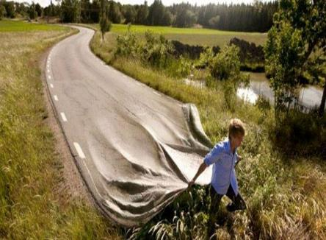
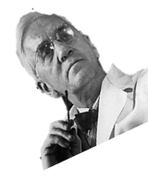
Serendipity
Is it possible to create the conditions that might pave the way for serendipity?
Accidently finding something good that you have not been looking for.
Be curious. Be interested.
Be present. Notice things!
Put yourself out there!
Be open to new experiences!
Here’s an interesting thought…
And maybe serendipity will find you!
Build a mentality that sees potential and opportunity!

Slide 7
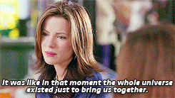
Thought for the Week is written to promote, encourage and foster your Spiritual, Moral, Social and Cultural learning.

